Slide 1
Hydrogen – chances and limits
Workshop Energy Policy and Transition, 21.11.2023, Most

Slide 2
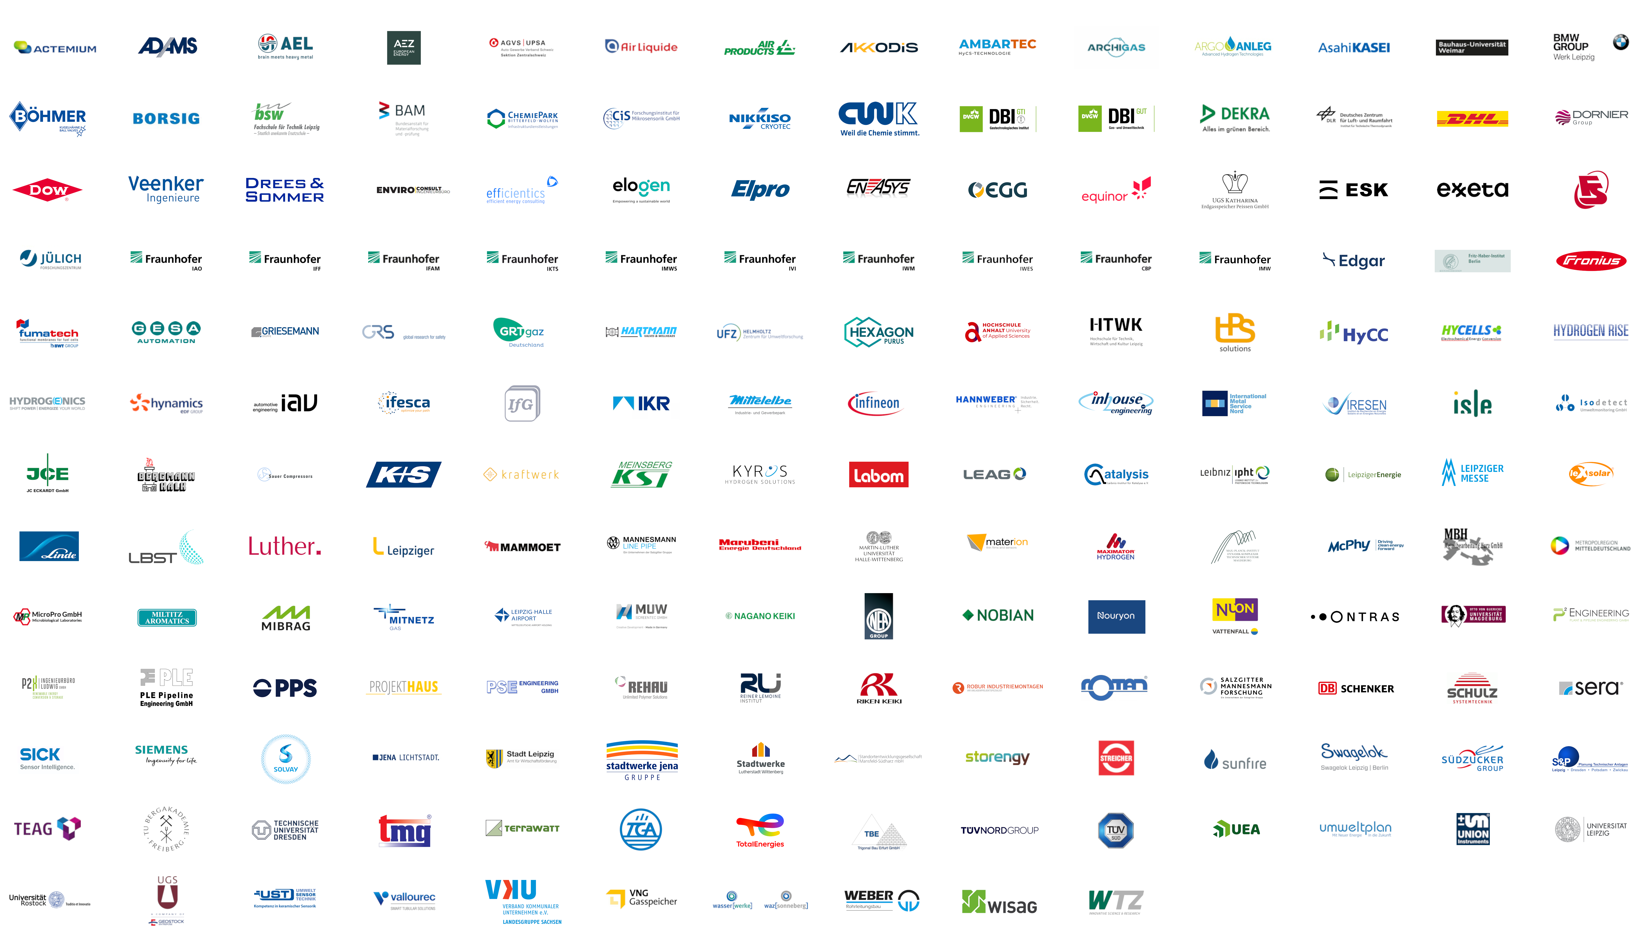
HYPOS – Members (> 170)
HYPOS > Hydrogen Power Storage & Solutions

Slide 3
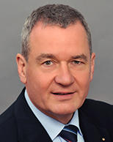
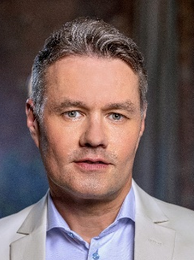

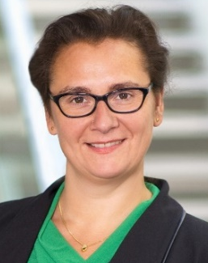
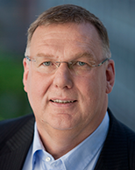
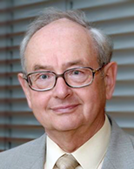
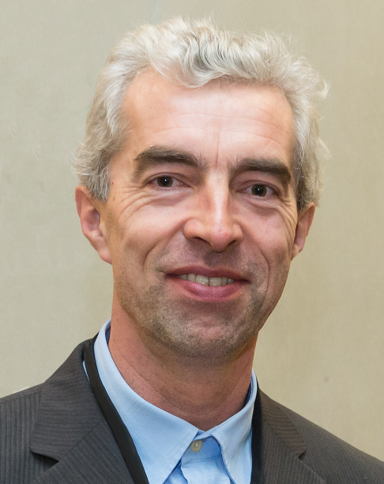
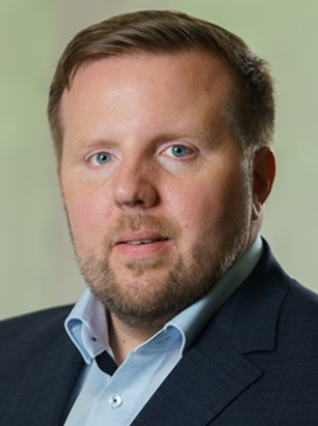
HYPOS-Board
HYPOS > Hydrogen Power Storage & Solutions
Jörn-Heinrich Tobaben
1st Deputy Chairman
Metropolregion
Mitteldeutschland
Management GmbH
Dr. Joachim Wicke
Chairman
Siemens AG
Cornelia Müller-Pagel
2nd Deputy Chairwoman
VNG AG
Dr. Sylvia Schattauer
Fraunhofer IWES
Axel Klug
Honorary Member
Dr. Christoph Mühlhaus
Cluster Chemistry
Honoray Member
Thomas von der Heide
Terrawatt Planungsgesellschaft mbH
Dr. Hubert Schillings
Mitteldeutsche Braunkohlengesellschaft mbH
Dirk Sattur
MITNETZ STROM

Slide 4
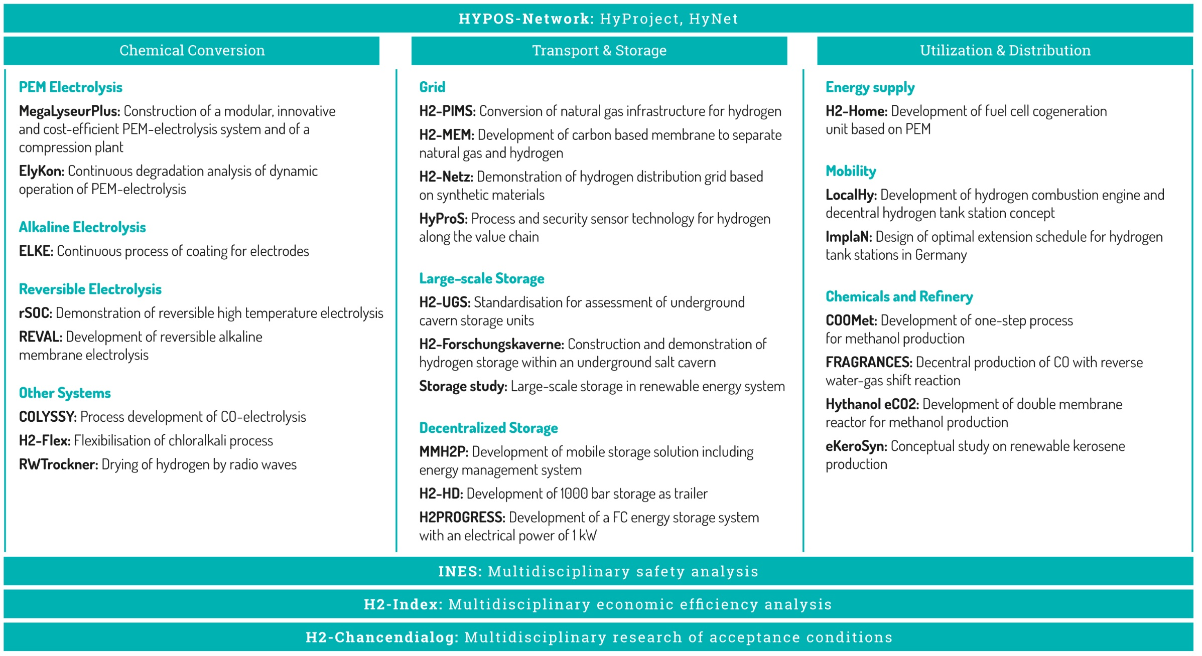

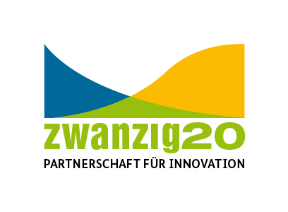
HYPOS – R&D Projects since 2013
HYPOS > Hydrogen Power Storage & Solutions
34 R&D Projects
45 Mio. € Funding
> 70 Mio. € Total Funding

Slide 5
Hydrogen applications in Germany 2023
Hydrogen use in Central Germany
Hydrogen has been used for decades in the chemical industry for the production of e.g.:
ammonia (fertilizer)
methanol
fuels
Hydrogen is produced as a by-product of chlorine prodcution.

Slide 6
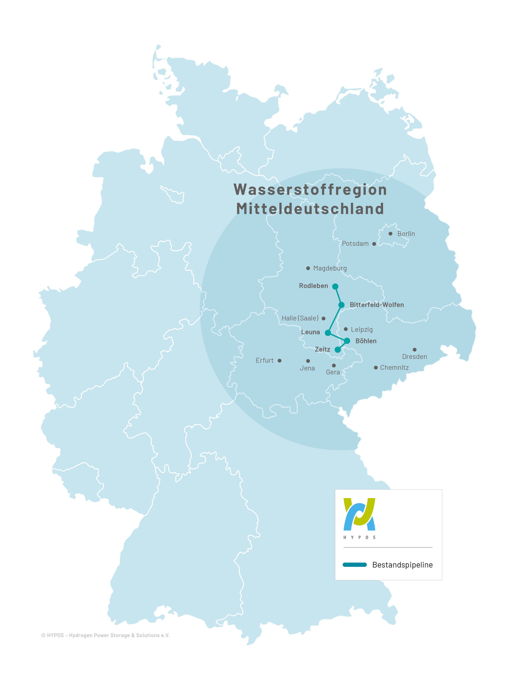
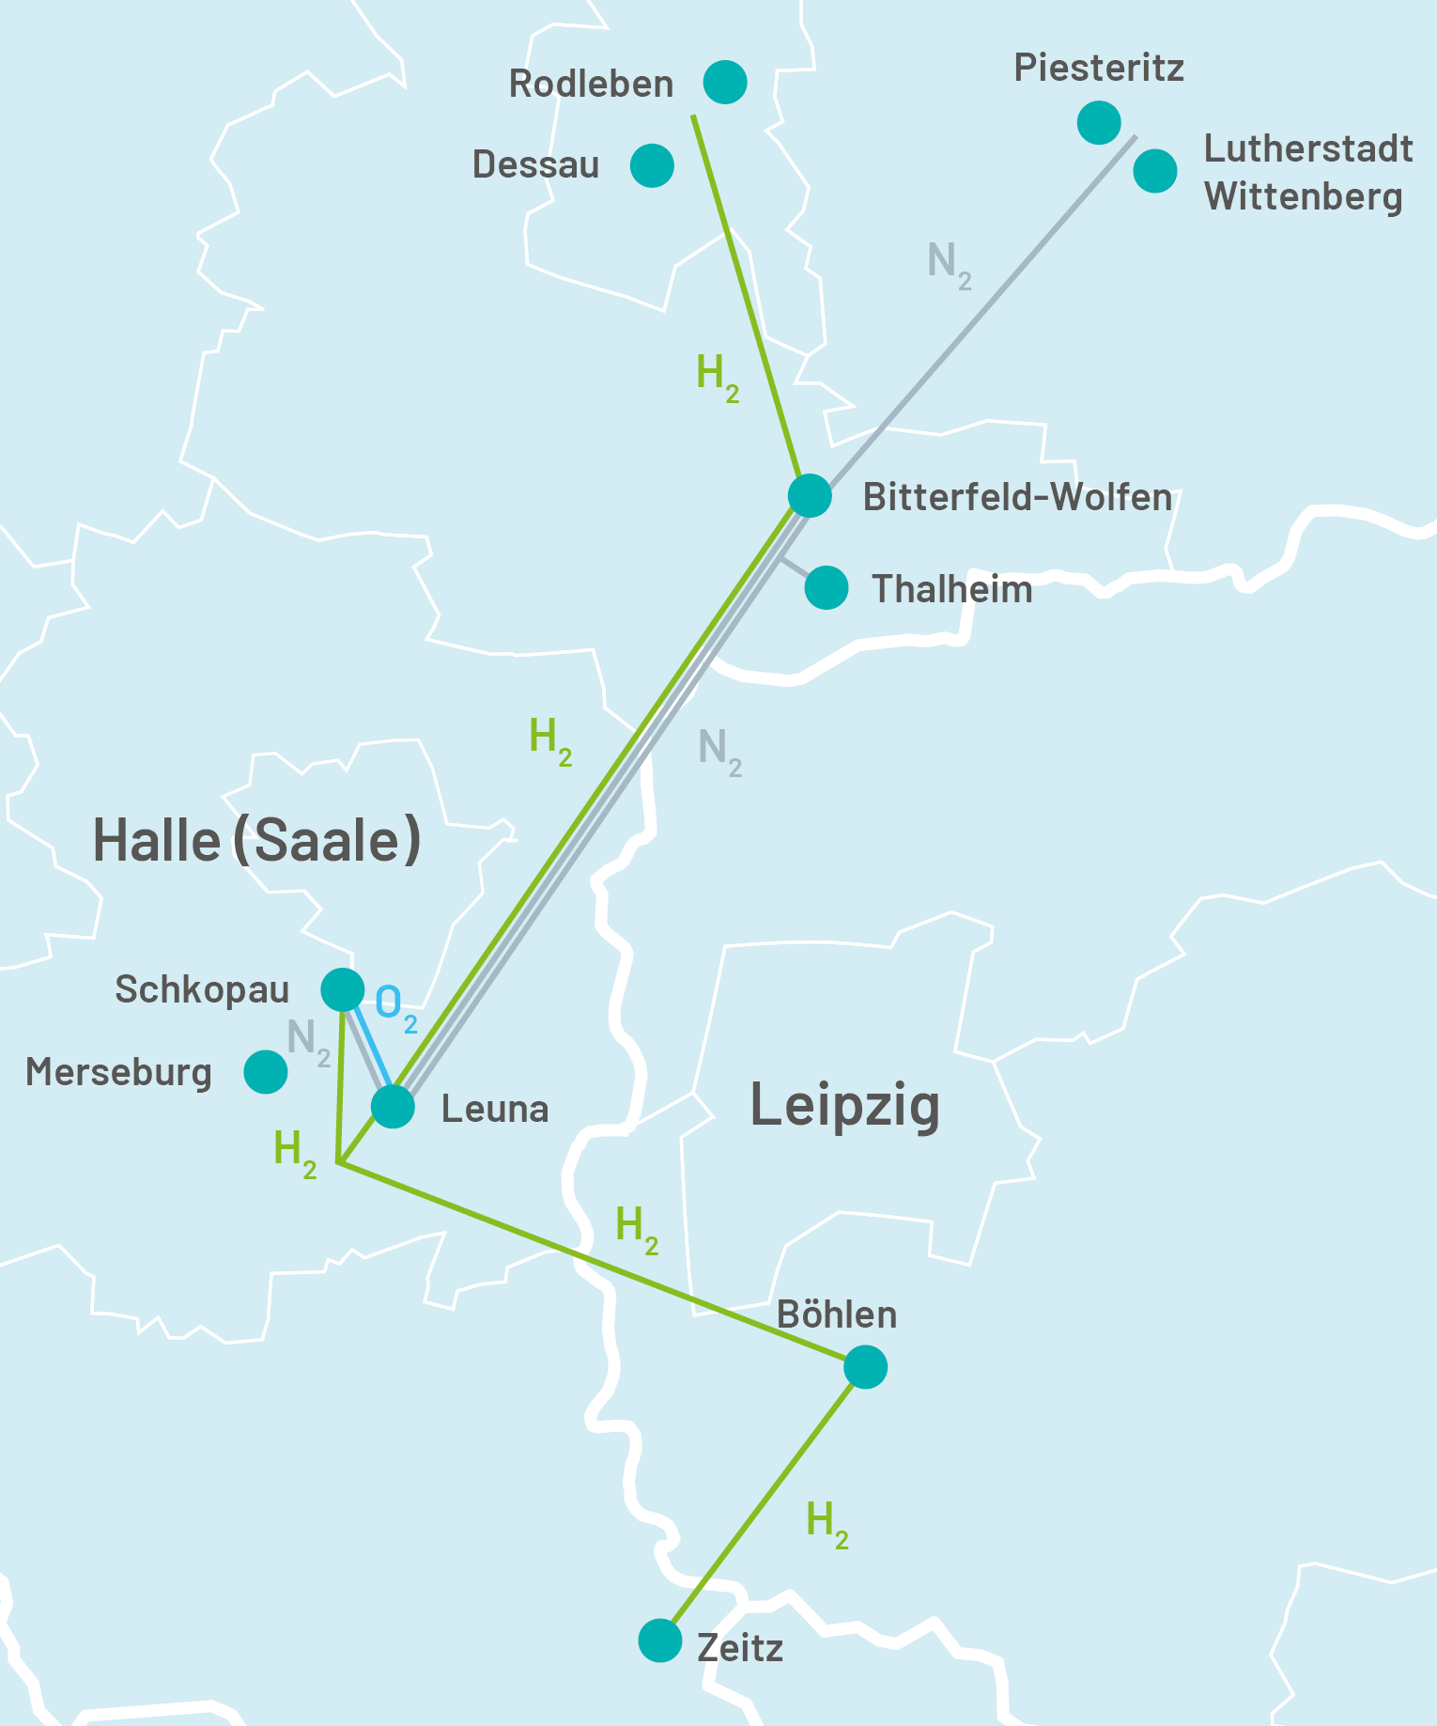
Hydrogen in Central Germany - overview
Hydrogen use in Central Germany
2nd longest hydrogen pipeline in Germany (150 km)
existing hydrogen production and industrial demand:
  5.3 billion Nm³/a = 15,9 TWh/a
xxisting know-how of companies und R&D institutes
large potential for H2 underground stroage in salt caverns
HYPOS – largest, oldest and most funded H2 network in Germany

Slide 7
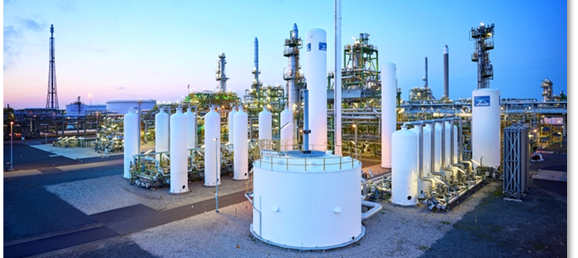
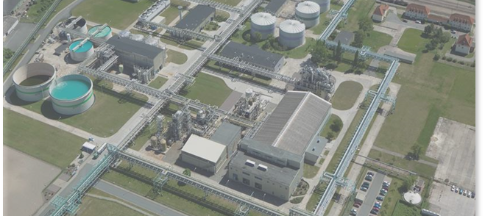
Hydrogen production in Central Germany
Hydrogen use in Central Germany
Chemical Park Leuna
Linde, steam reformer:
  100,000 Nm³/h H₂ ; 700,000 t/a CO₂
Linde, 24 MW PEM-electrolyser
  4,800 Nm³/h H₂
Chemical Park Bitterfeld-Wolfen
Nobian, Chlor-alkali-electrolyser
  3,000 Nm³/h H₂
  90,000 t/a chlorine
  TÜV Süd certified Green H2

Slide 8
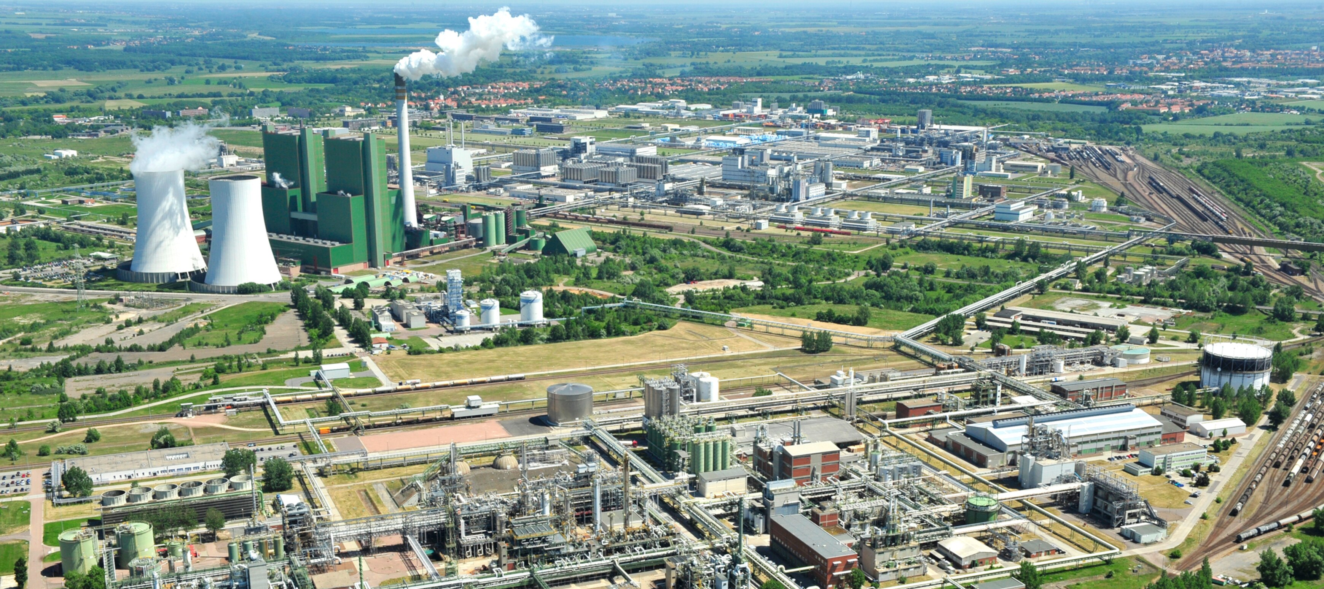
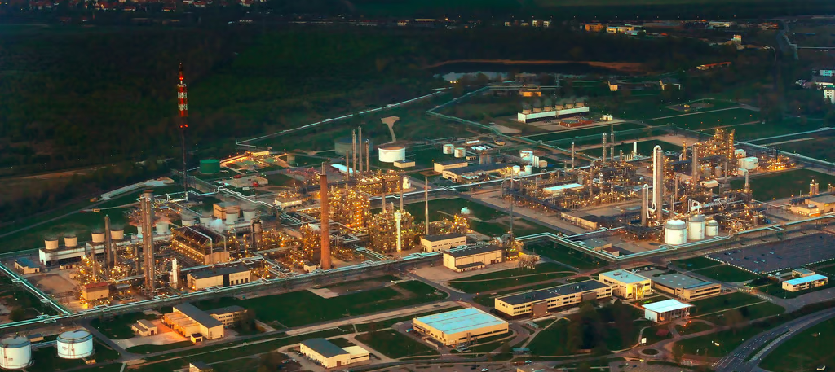
Hydrogen production in Central Germany.
Hydrogen use in Central Germany
Schkopau, Böhlen
DOW Plant, Chlor-alkali-electrolysis, by-product of ethylene/styrene production (own use)
  Approx.. 32,000 Nm³/h H₂ (assumption: 7500 operating hours per year)

Slide 9
Hydrogen demand in Central Germany
Hydrogen use in Central Germany
Large-scale H2 consumers:
SKW Piesteritz (Lutherstadt Wittenberg)
  Product: ammonia
  H₂-demand today: 6.5 TWh/a
Total Energies (Leuna)
  Product: refining, methanol
  H₂-demand today: 6.1 TWh/a
Other regional consumers:
  DOMO Chemicals (Leuna): Caprolactam H₂-demand: 690 GWh/a
  Radici Chimica (Zeitz): Adipic acid H₂-demand: 155 GWh/a
  Arkema (Leuna): Hydrogen peroxide H₂-demand: 150 GWh/a
  DHW (Rodleben): Ester H₂-demand: 12 GWh/a
  Leuna-Harze (Leuna): Hydrogen chloride H₂-demand: > 1 GWh/a

Slide 10
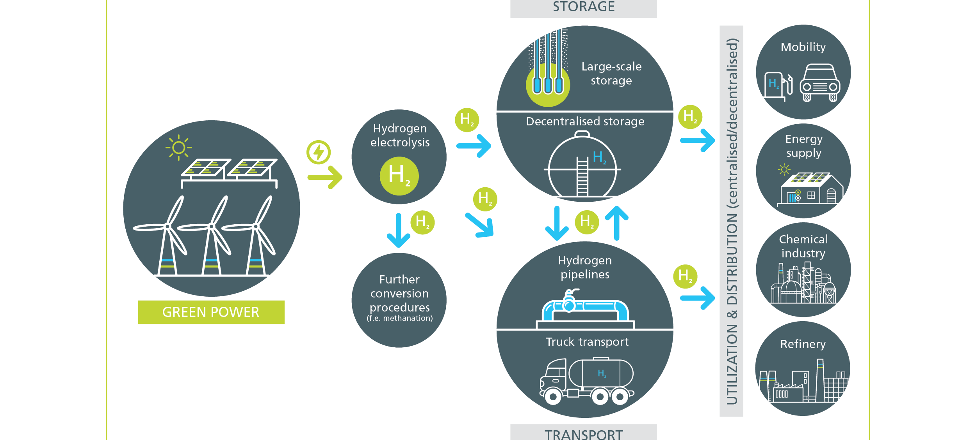
HYPOS-focus: Green Hydrogen Value Chain
HYPOS > Hydrogen Power Storage & Solutions

Slide 11
Bottleneck factors of the green hydrogen economy
Overview of bottleneck factors
Availability of water at the planned electrolysis sites: There is currently no (regional) "water budget plan“, that systematically compares existing availability and demand.
Availability of green electricity (wind, PV, biomethane, etc.): All available studies predict a serious excess demand for green electricity.
110 KV/380 KV grid connection: highly expandable German extra-high-voltage grid with the aim of importing green electricity in particular from other parts of Germany/Europe with decades of planning/construction periods
Grid infrastructure: Apart from the existing H2 network owned by DOW and LINDE (i.e. material use of H2 as a chemical raw material to supply the chemical parks), there is no transport infrastructure via pipelines in Central Germany.

Slide 12
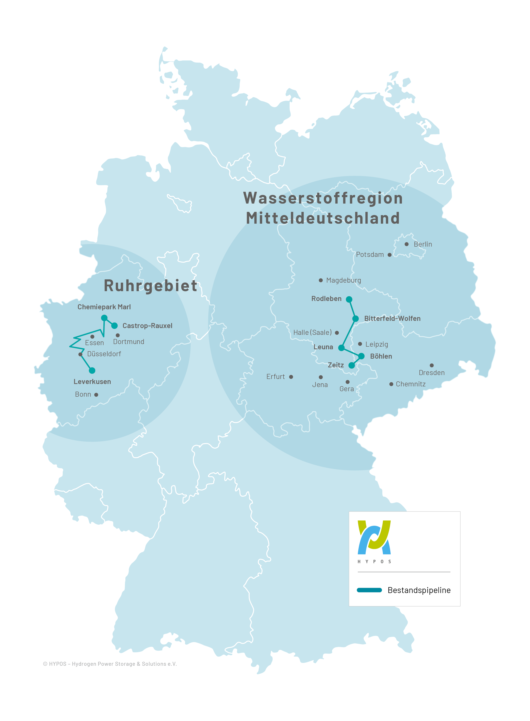
Hydrogen piplines in Germany
Overview of bottleneck factors
2nd largest hydrogen pipeline in Germany (150km)
Connecting different chemical parks:
  Rodleben
  Bitterfeld-Wolfen
  Schkopau
  Leuna
  Böhlen-Lippendorf
  Zeitz

Slide 13
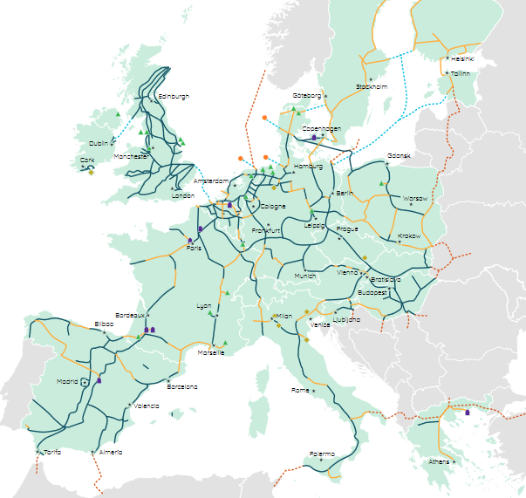
European Hydrogen Backbone
Bottleneck pipeline infrastructure
For Europe to achieve its climate and energy target, a European hydrogen infrastructure is needed. Green hydrogen is increasingly seen as an important part of the solution, alongside electrification, and the large clusters for future supply and demand are spread across Europe.
This makes it possible to transport hydrogen over long distances at an affordable cost. A hydrogen infrastructure will be built that will lead to a cohesive ecosystem by 2040.

Slide 14
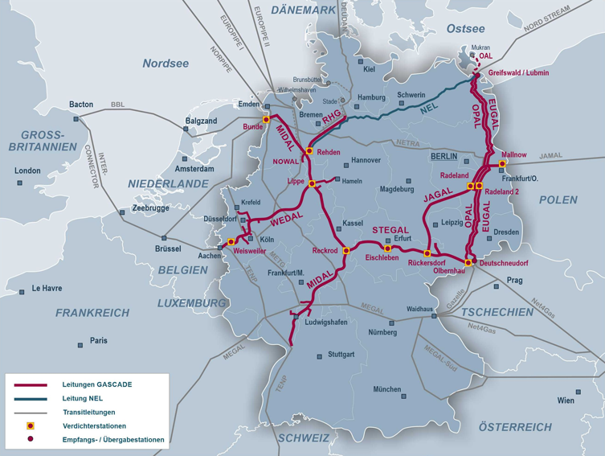
GASCADE‘s gas pipeline network
Bottleneck pipeline infrastructure
X
The OPAL (Baltic Sea Pipeline Connection Pipeline) is a pipeline (DN 1400) for the transport of natural gas from Lubmin in the northeast of Mecklenburg-Vorpommern to the south through the states of Brandenburg and Saxony. It connects the Nord Stream 1 pipeline with the German-Czech border at the terminus at Olbernhau/Brandov (CZ). At Olbernhau (or Sayda) there is a connection to the Transgas pipeline, which comes from Ukraine via the Czech Republic. (=> H2 project FLOW)
The EUGAL (European Gas Connection Pipeline) is a natural gas pipeline from the German Baltic Sea coast to the Czech Republic, which was built in 2019 largely parallel to the route of the already existing OPAL pipeline over about 480 kilometers from Lubmin on the Baltic Sea coast to Deutschneudorf in Saxony and from there to the Czech Republic.

Slide 15
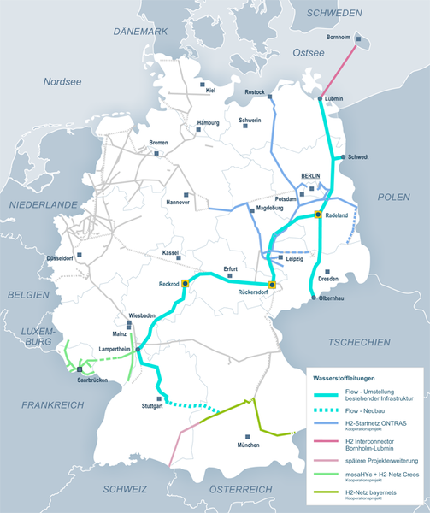
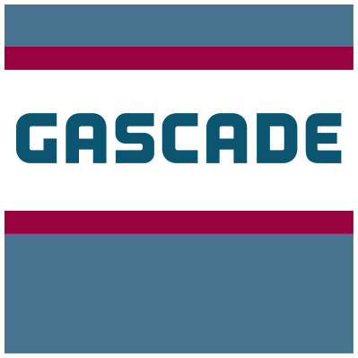
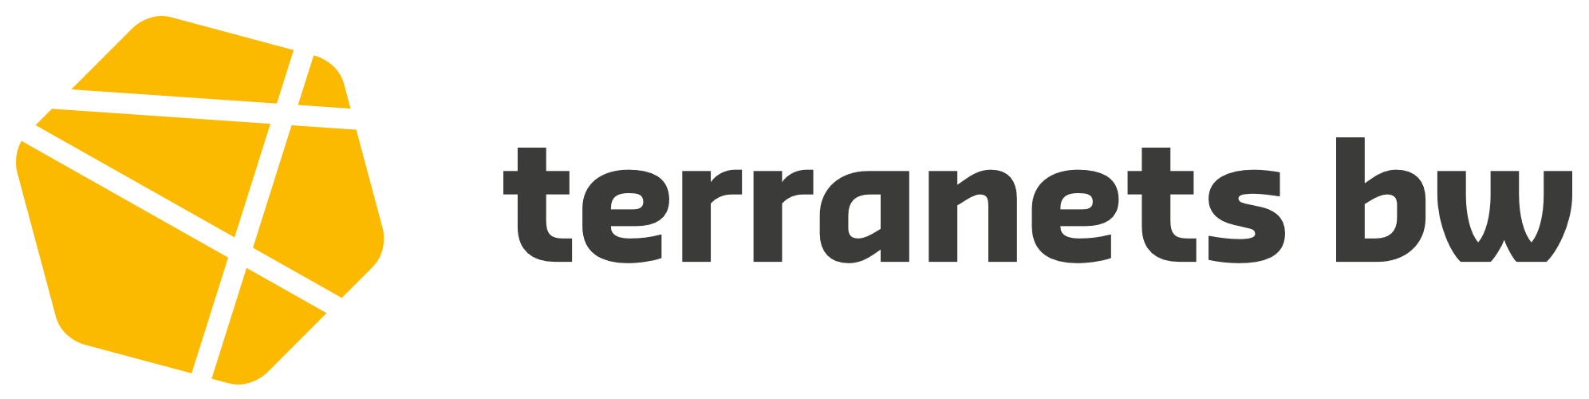


H2-Pipeline-Project FLOW
Bottleneck pipeline infrastructure
X
FLOW consortium: With the project Flow – making hydrogen happen, we plan to create a high-performance pipeline system for green hydrogen. We link international hydrogen markets and thus open up procurement opportunities for large quantities of hydrogen for industry in Europe. The first pipeline sections could be converted as early as 2025. As a result, CO2 emissions can be reduced faster than before. With Flow – making hydrogen happen, we are delivering an important building block for the European hydrogen ramp-up and the energy transition.
Existing infrastructure is to be used to quickly open up important regions in Europe for the hydrogen ramp-up. Flow – making hydrogen happen connects the Danish "energy island" of Bornholm with the Czech Republic.

Slide 16
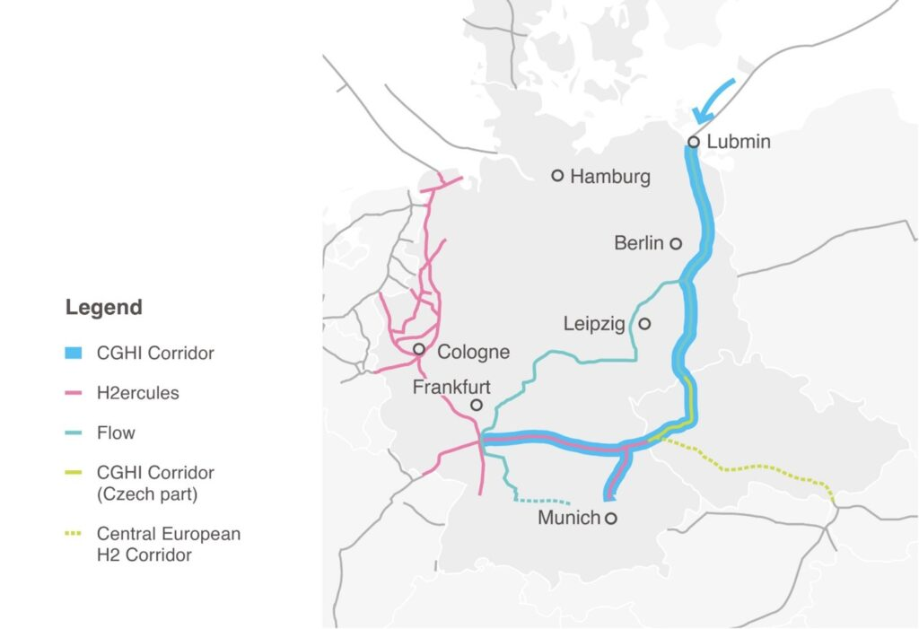
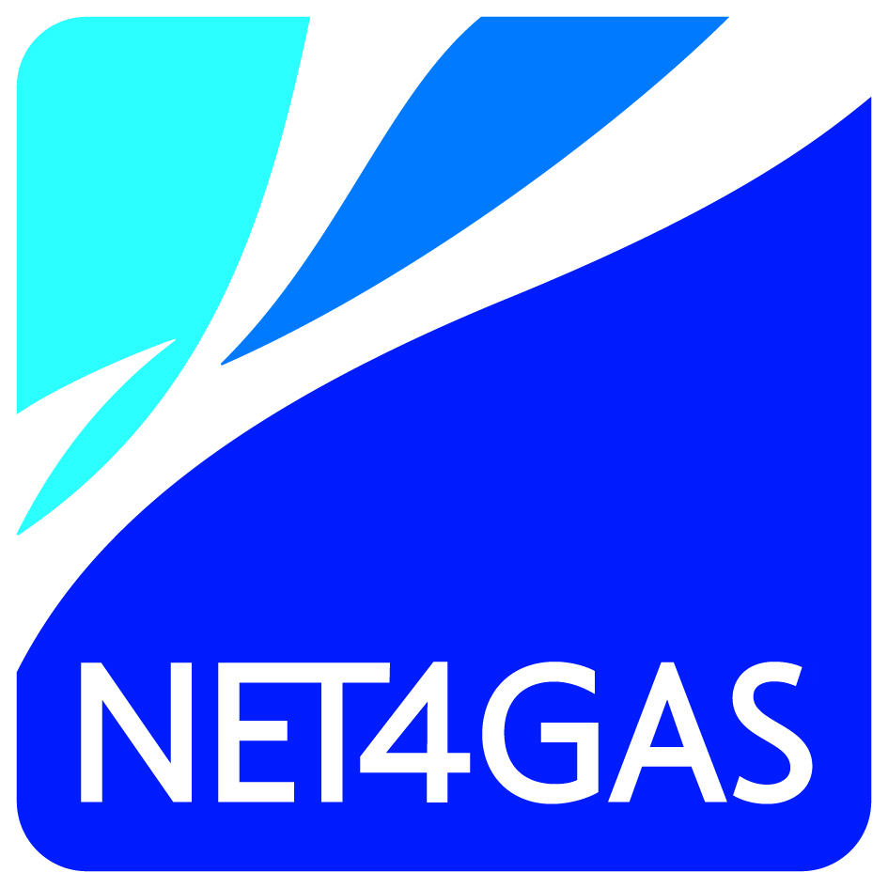
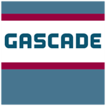
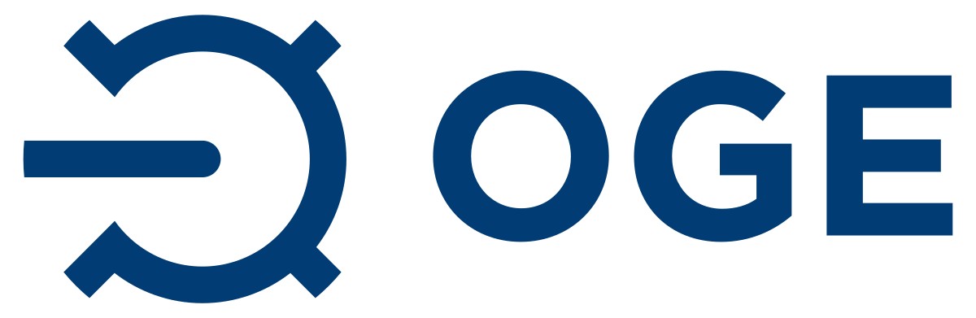
Czech-German Hydrogen Interconnector (CGHI)
Bottleneck pipeline infrastructure
CGHI Vision: The vision of the Czech German Hydrogen Interconnector (CGHI) initiative is to create a hydrogen interconnector to connect high potential hydrogen supply areas in Northern Germany and the Baltics with expected high demand clusters in the EU (predominantly in South Germany and Northern Bohemia). Additionally, it will also enable connection of local suppliers and consumers along the corridor. The initiative was launched in 2022 by three gas infrastructure companies: GASCADE, NET4GAS and OGE.

Slide 17
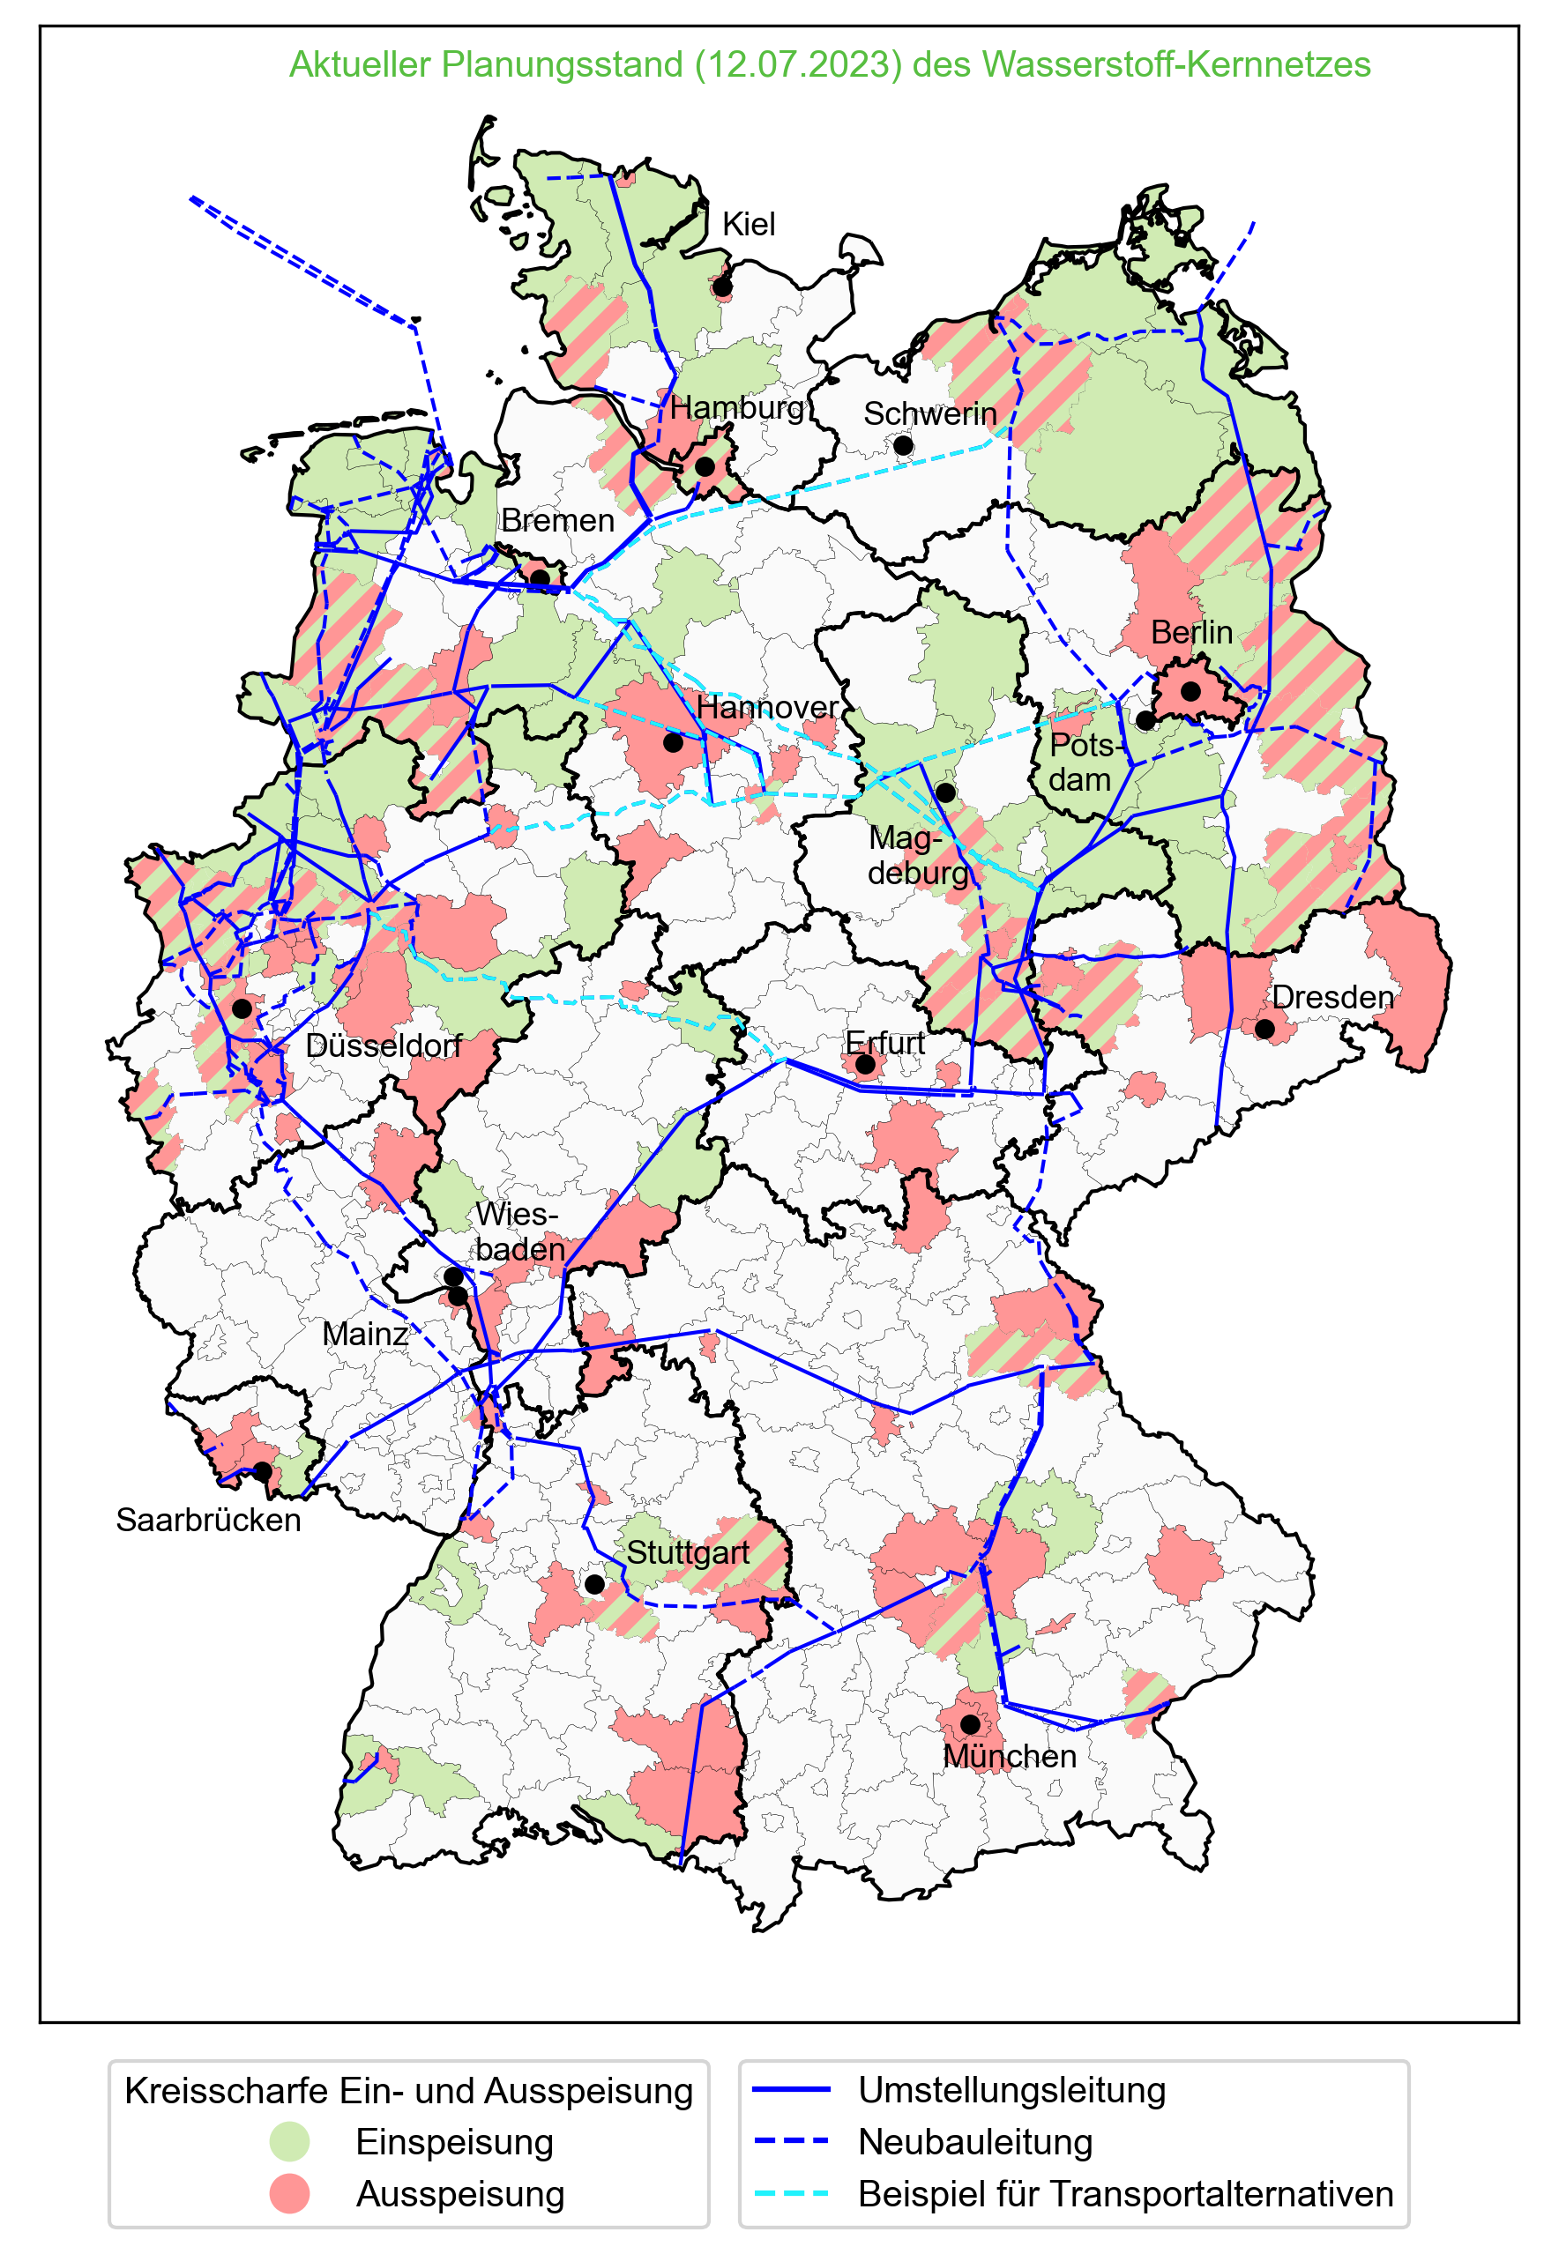
Hydrogen core network for Germany (by 12.07.2023)
Bottleneck pipeline infrastructure
intended to open up existing large consumption and podruction regions with H2
  Industrial centers
  Storage facilities
  Power plants
  Import corridors
length: 11.200 km
xxit capacity: 87 GW
commissioning by 2032
funding: in progress

Slide 18
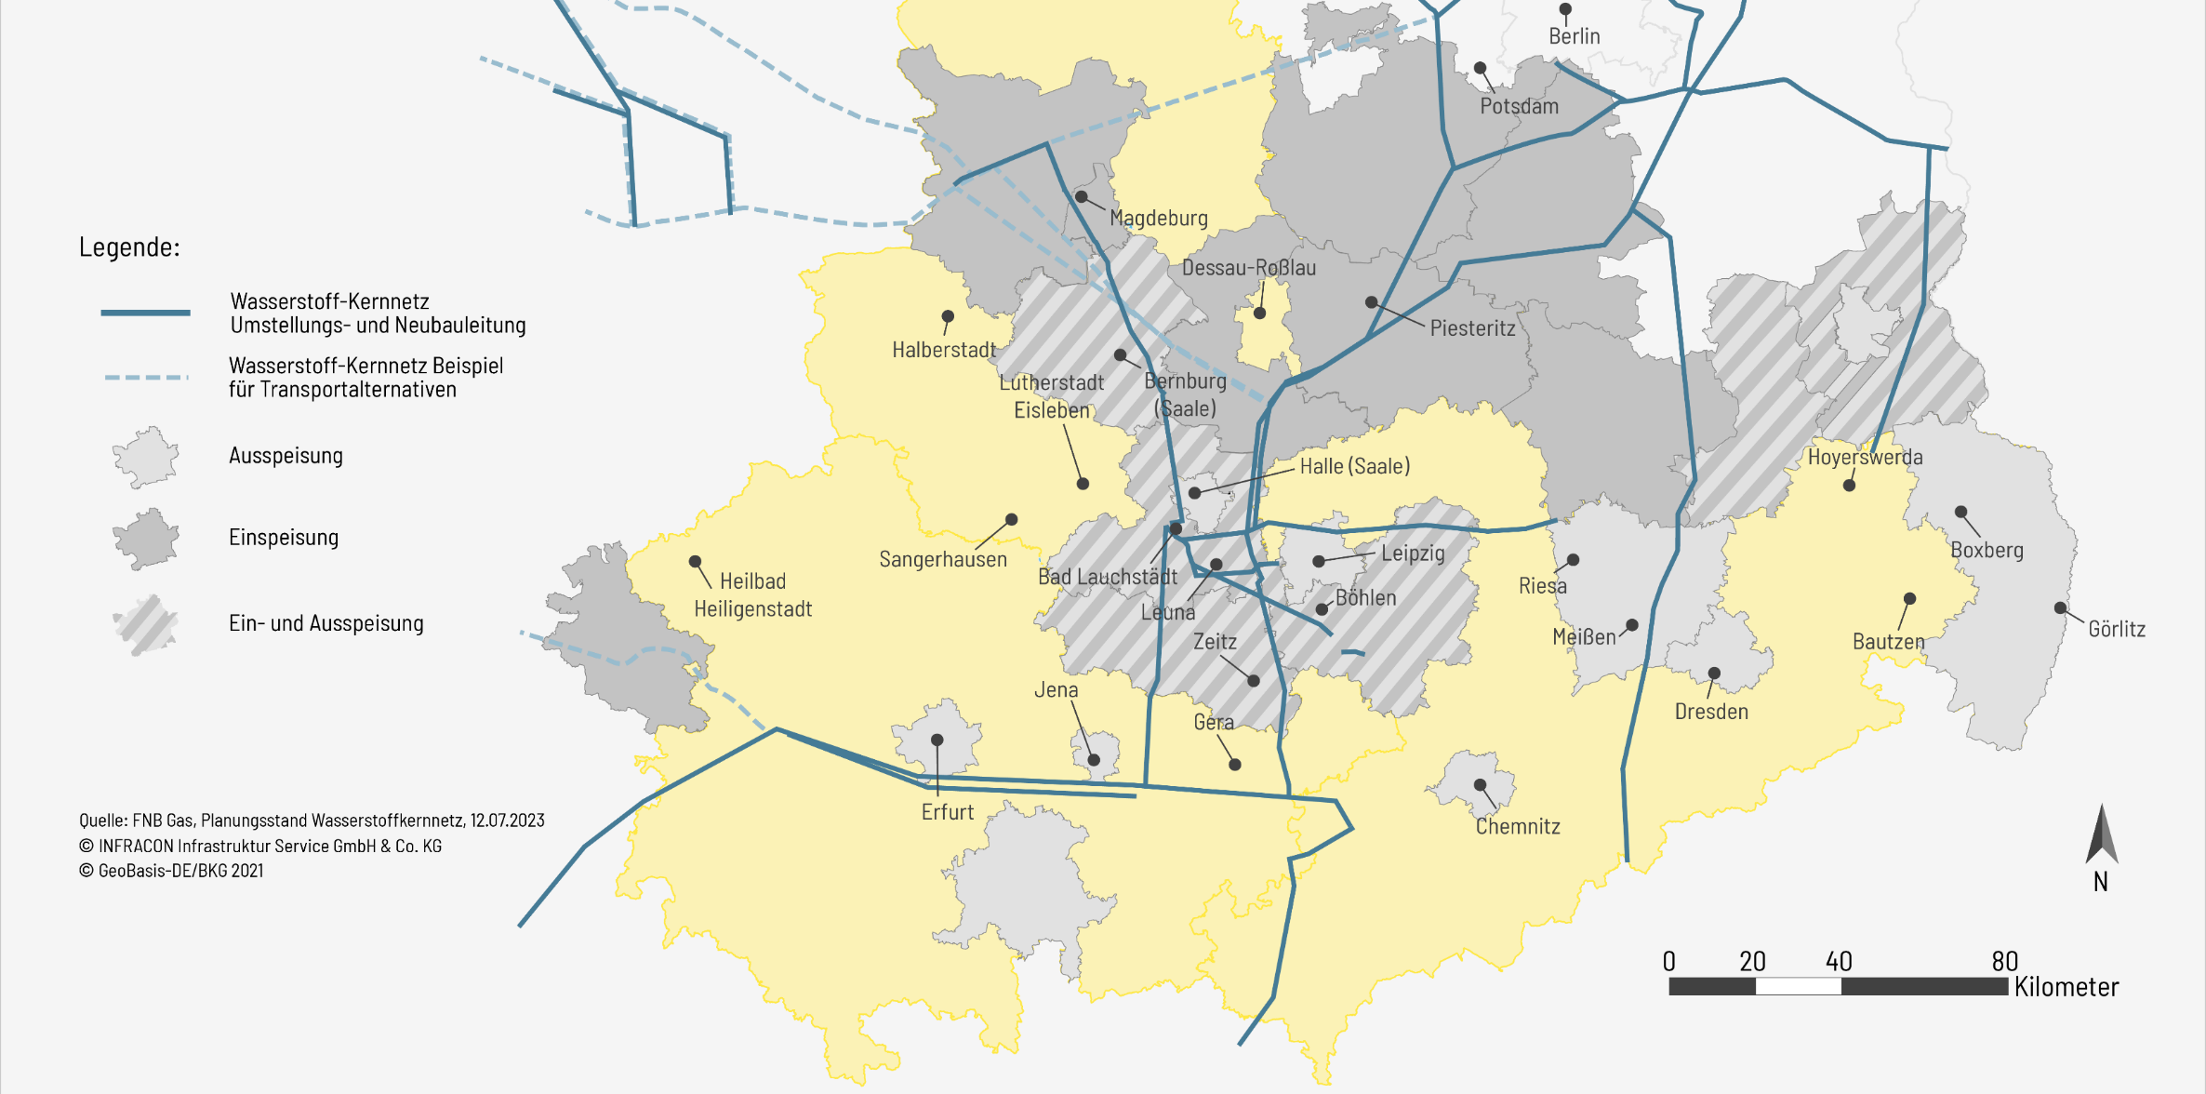
Current planning status for the Central German Hydrogen Core Network
Stand Juli 2023

Slide 19


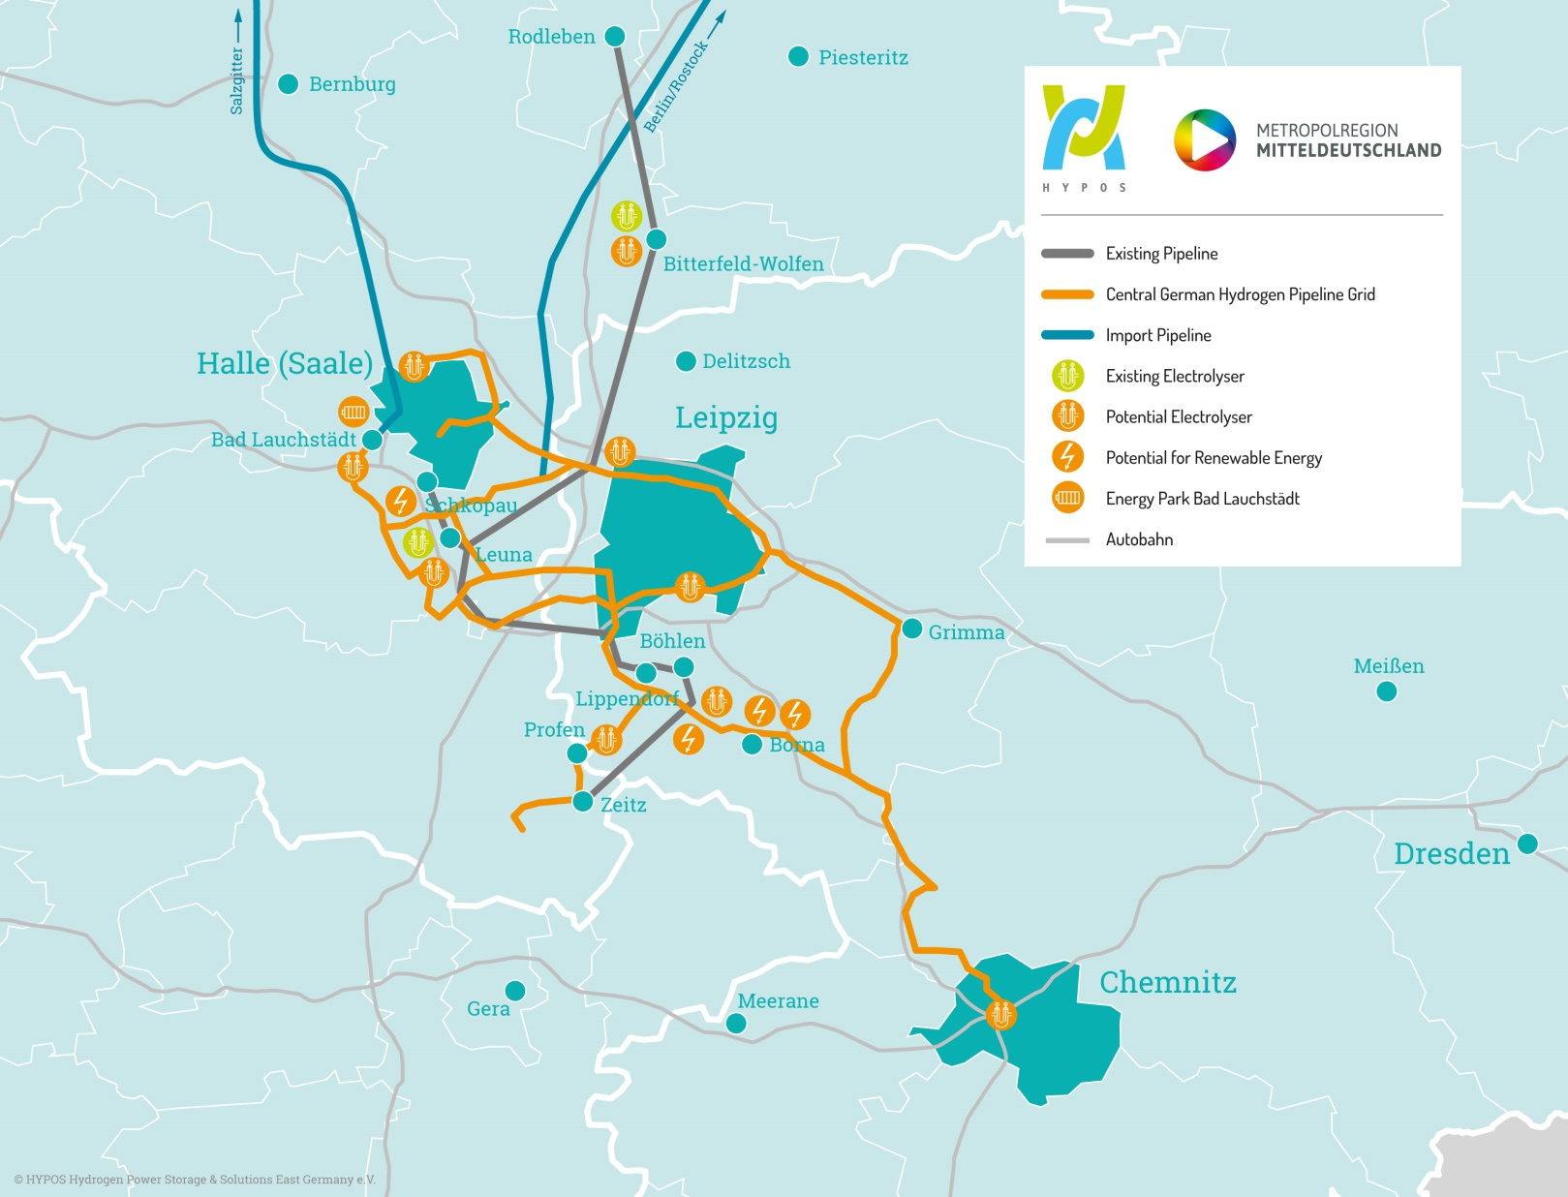

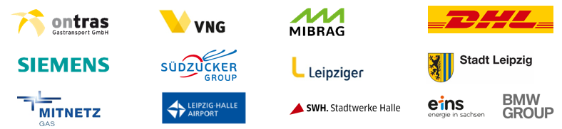

Results of the joint study: Hydrogen Network
Central Germany 1.0
Results by 22.04.22:
total length: 339 km (40% conversion; 60% construction)
pipeline segments: 13
total investment: 422-610 Mio €
regional H₂-demand: 20 TWh/a
regional H₂-supply: 2,5 TWh/a
infrastructure realisiation by construction, conversion or
route pooling
import infrastructure via
Rotterdam and Rostock
Notes:
Sprecher: Tobaben 10‘

Slide 20
Objectives and contents of Study 2.0
Hydrogen Study 2.0: 4 pillars of the extended infrastructure study
H₂-demand
H₂-potential
Infrastructure
Law and politics
access to comprehensive inventory data and technology-related experience
assessment of potential H₂ demand among new study partners
identification of further customers and space potentials
inclusion of existing renewable energy plants in the extended area of consideration
scientifically sound methodology for the determination of PV/wind power area potentials
access to comprehensive inventory data from DBI-GIS database
consideration of relevant trade-offs in the use of renewable energies
gradual expansion of the H₂ network for further interested parties
examination of network operators' conversion options
technically flawless and demand-oriented dimensioning
determination of total investment and operating costs
development of concrete schedules and implementation steps
scientific review of the current national and European status
clear compilation for approval and operation of H₂ networks
support for political and social communication

Slide 21
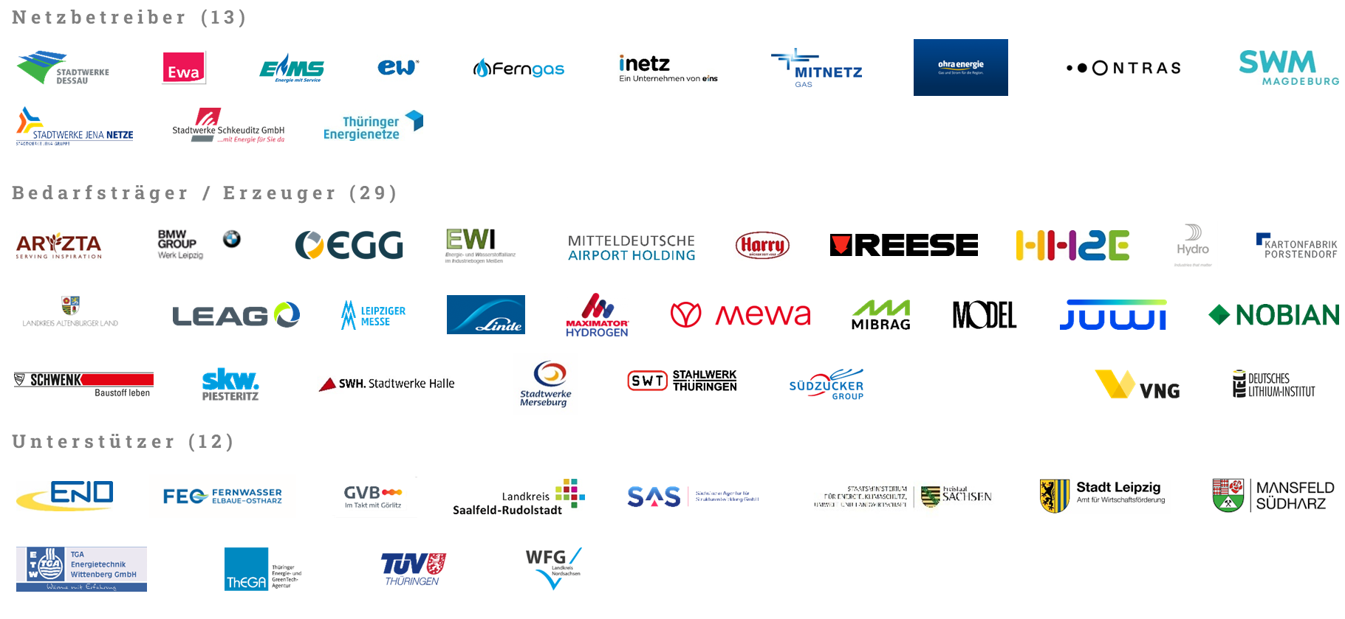
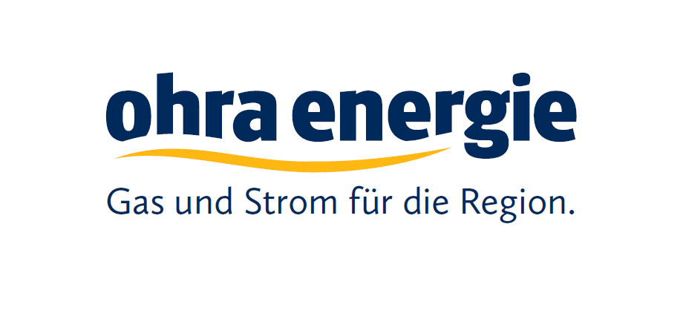

Partners in the Joint Study 2.0 ( total 54)

Slide 22
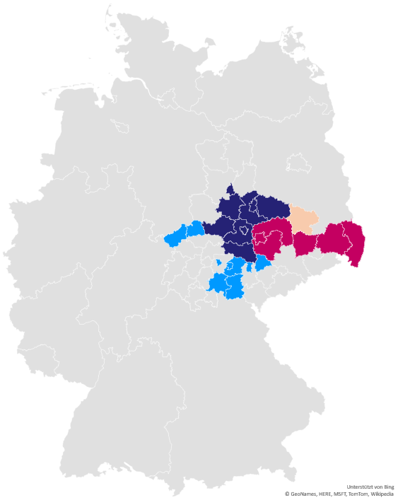
Graphical evaluation of the reported connection points as part of the Study 2.0
(54 partner)
Brandenburg
Saxony
Saxony-Anhalt
Thuringia

Slide 23
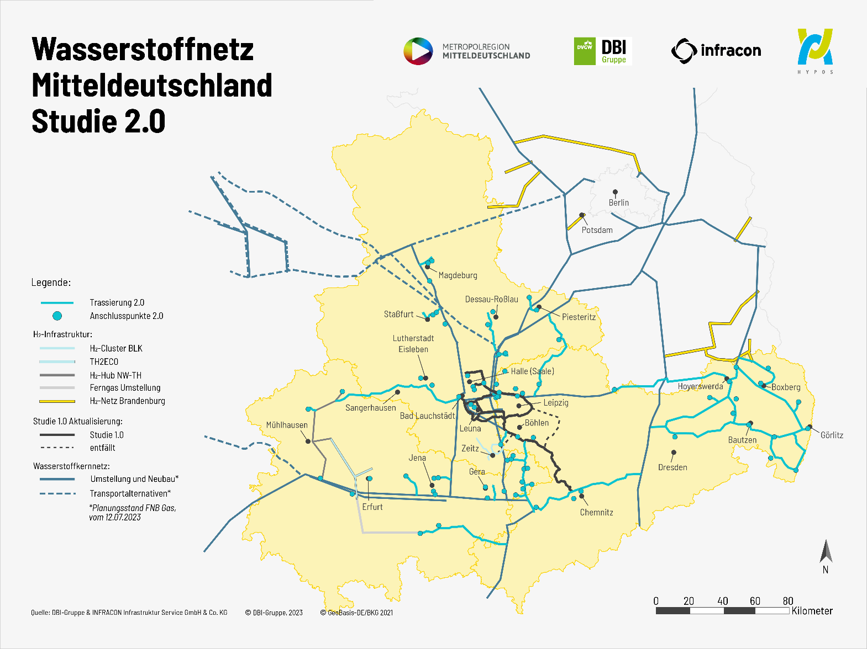
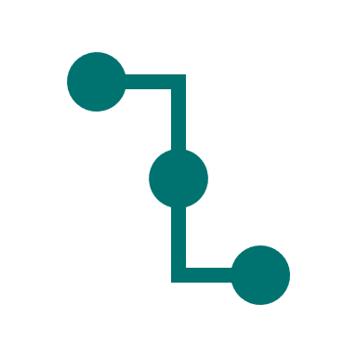
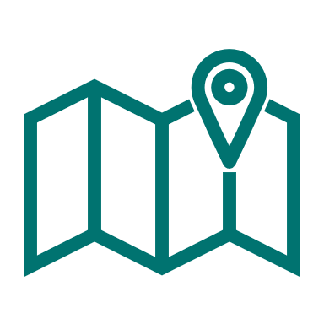

Summary by 06.11.2023
connection points: 79 incl. coordinates
routed length: ≈ 1,000 km
compression: > 16 bar
Thuringia: ≈ 190 km
Saxony: ≈ 610 km
Saxony-Anhalt: ≈ 160 km
Brandenburg: ≈ 40 km
  conversion: ≈ 380 km
  new construction: ≈ 620 km
  excluding bundling: ≈ 490 km
  including bundling: ≈ 130 km
Notes:
Pressure range >16 bar, sometimes up to 30 bar, as lines are mainly located at connection points in this pressure range
Figures refer only to red lines / pipelines – pure routing 2.0
Further conversions of NB are not included, such as long-distance gas

Slide 24
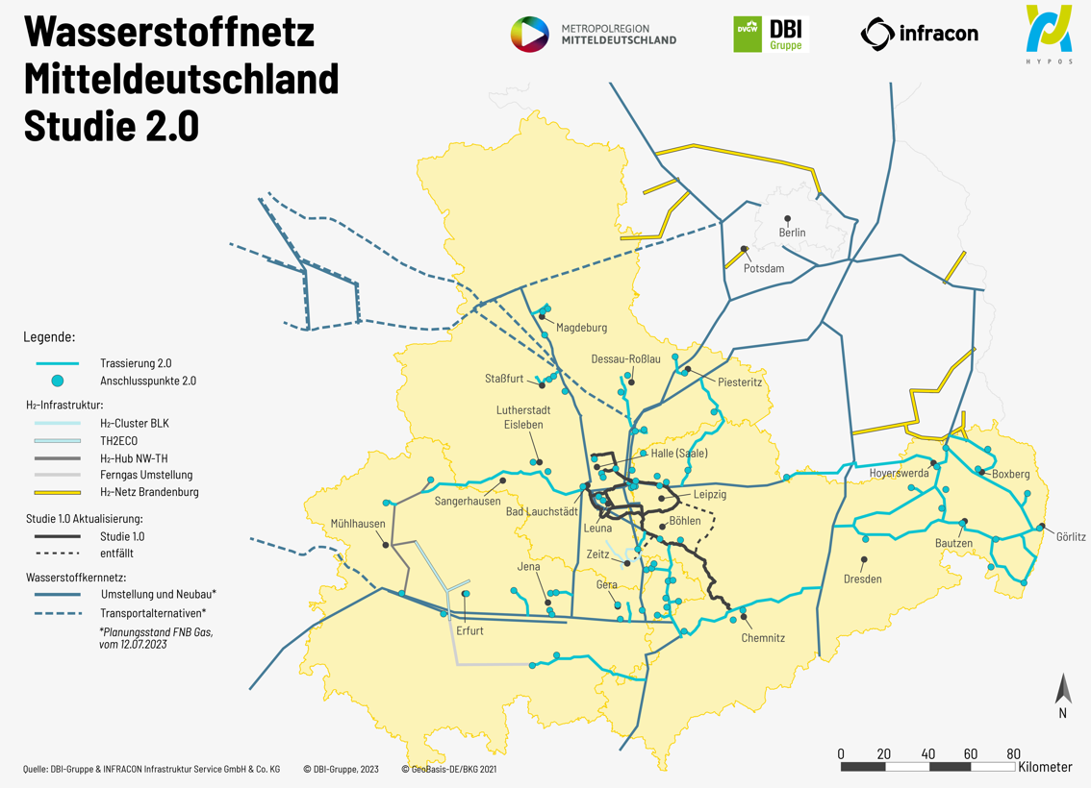

Slide 25
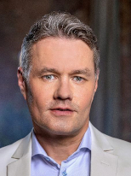
Hydrogen is economic power
Thank you for your attention!
Jörn-Heinrich Tobaben
Managing Director of the European Metropolitan Region of Central Germany & 1st Deputy Chaiman of HYPOS e.V.

