Slide 1
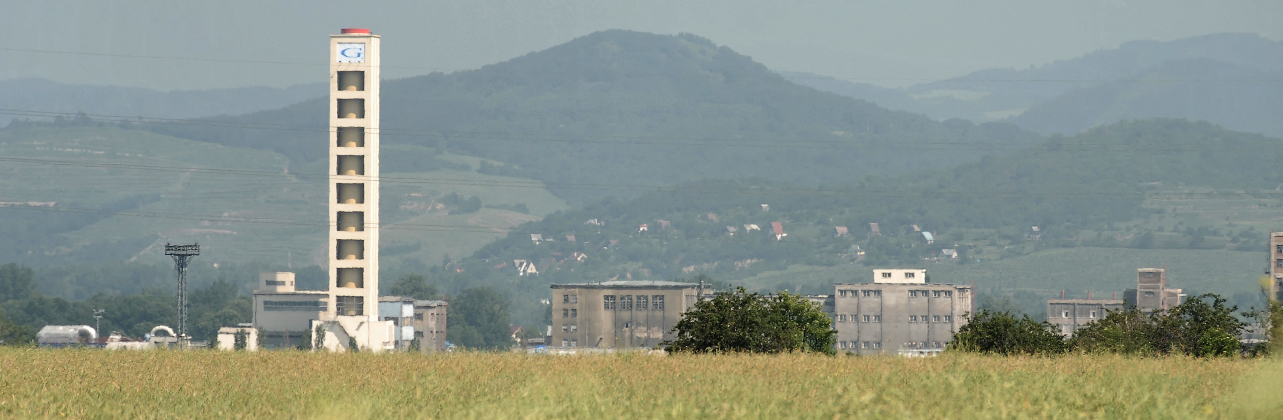
WELCOME TO
INDORAMA VENTURES MOBILITY BOHEMIA s.r.o.
CHEMICKÉ FÓRUM ÚSTECKÉHO KRAJE 26.09.2024

Slide 2




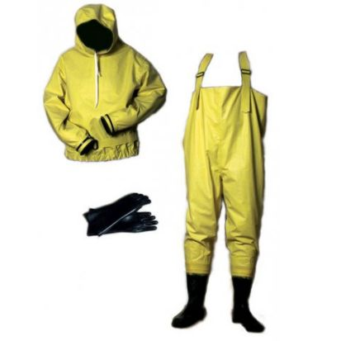

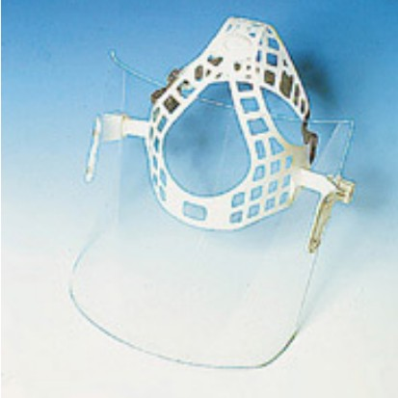





SAFETY MOMENT

Slide 3
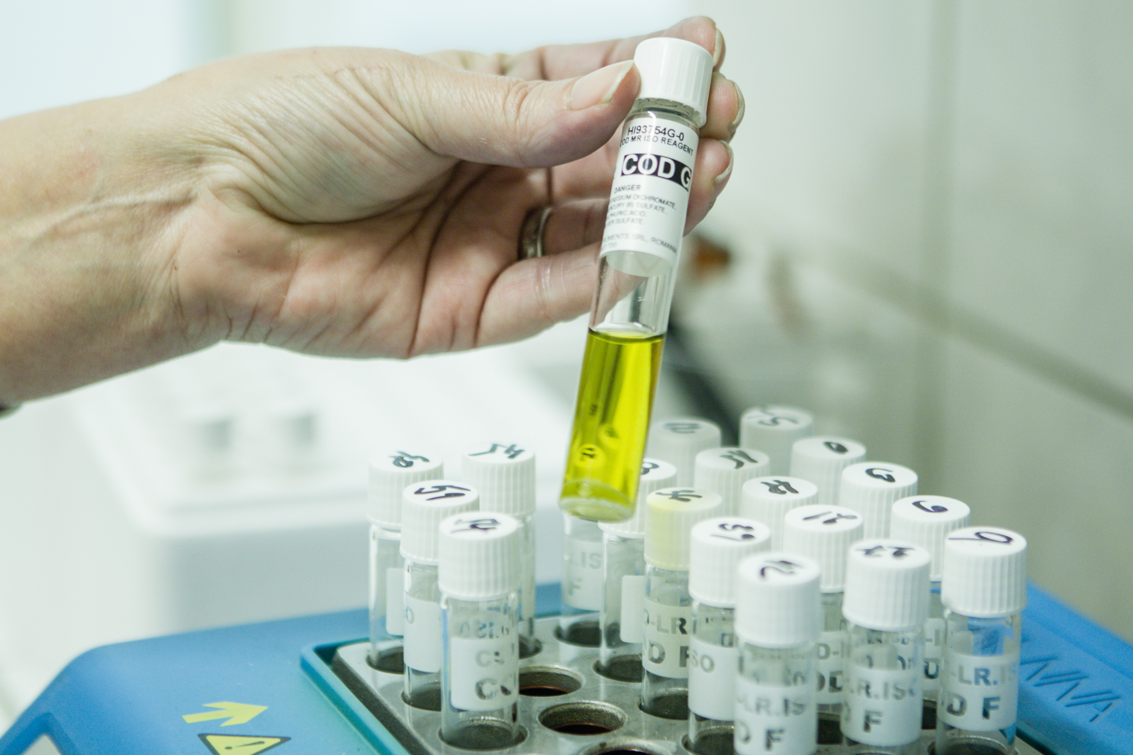
SCHEDULE
Welcome
Safety moment
Schedule
History
Location
Area
Headcount
Raw material & Chemicals
Utilities
Products
Certifications
Safety strategy
Safety reporting
Safety event
EHS Excellence award
Specific agenda – video
Thank you

Slide 4
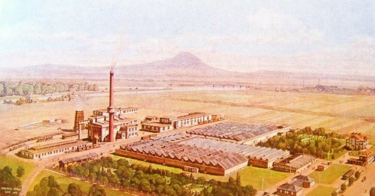
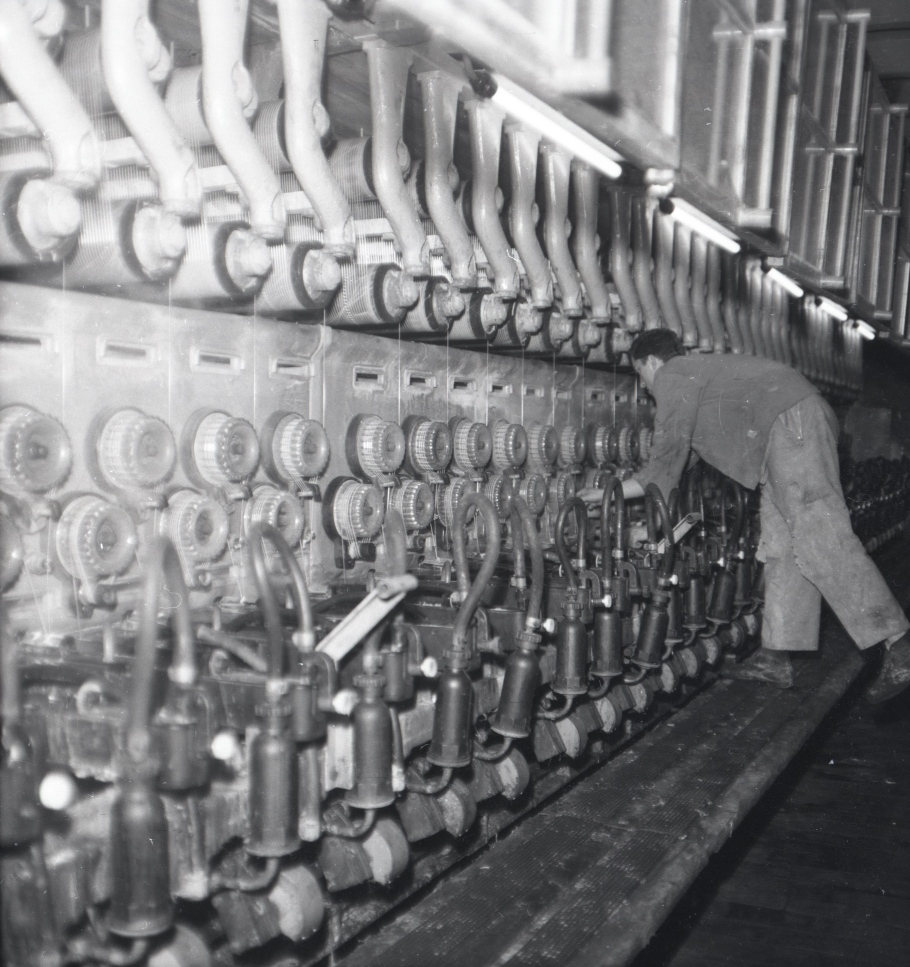
HISTORY
1923 Glanzstoff Fabrik
1960 New spinning

Slide 5
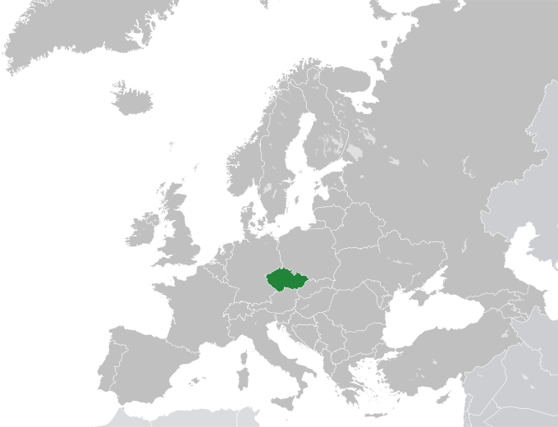
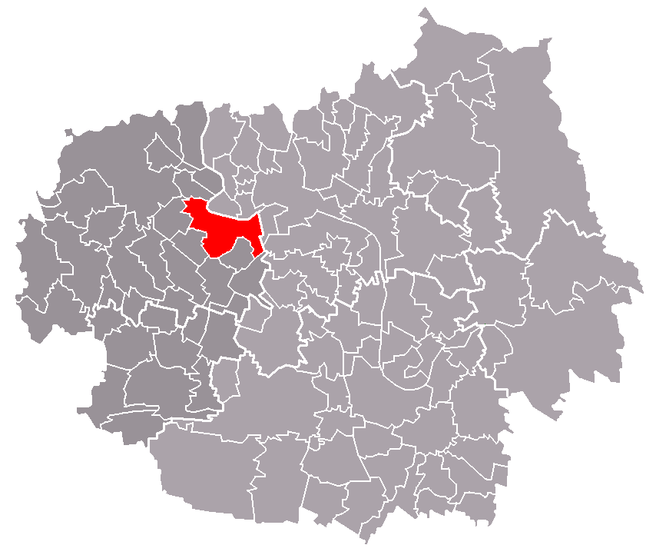
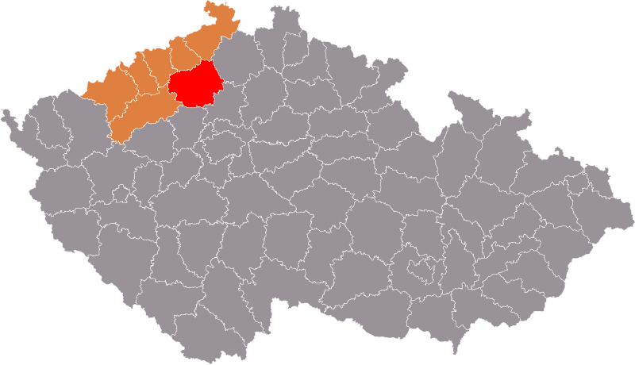





LOCATION
EUROPE > CZECH REPUBLIC > USTECKY REGION > LITOMERICE DISTRICT > LOVOSICE TOWN

Slide 6
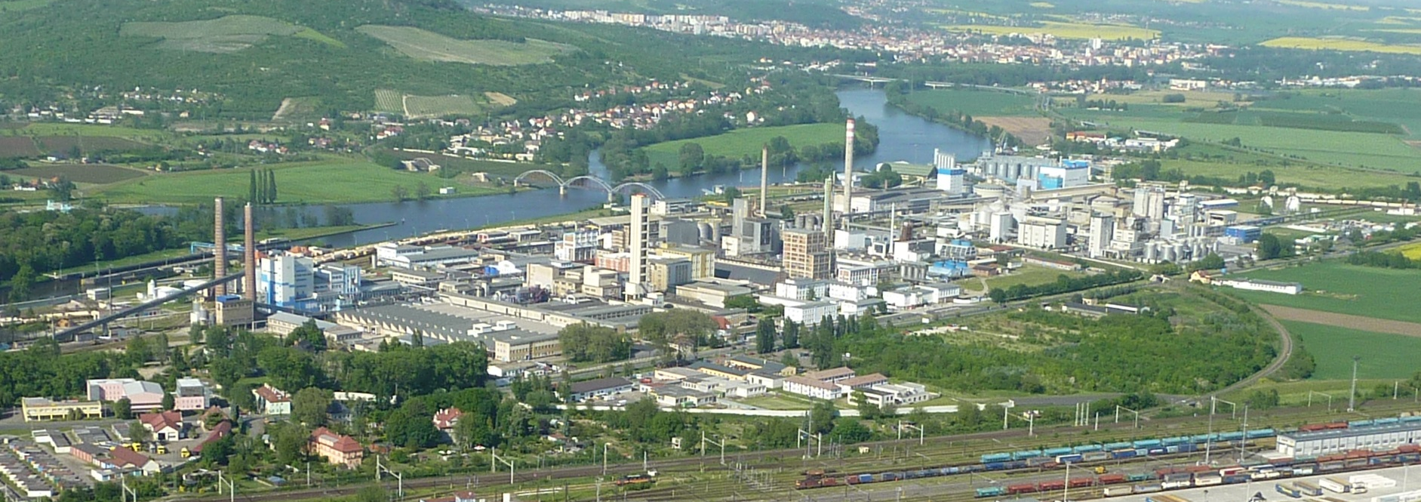




AREA
Litoměřice town
Labe river
Lovosice town

Slide 7
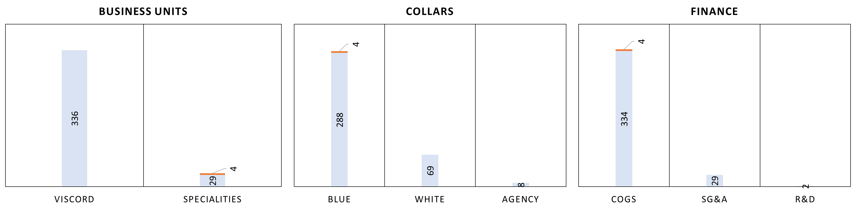
HEADCOUNT
Budget 2024
365 total
+ 4 with CAPEX to speciality spinning machine V6

Slide 8
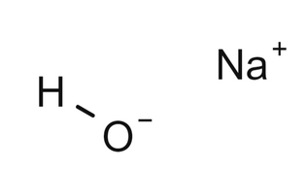
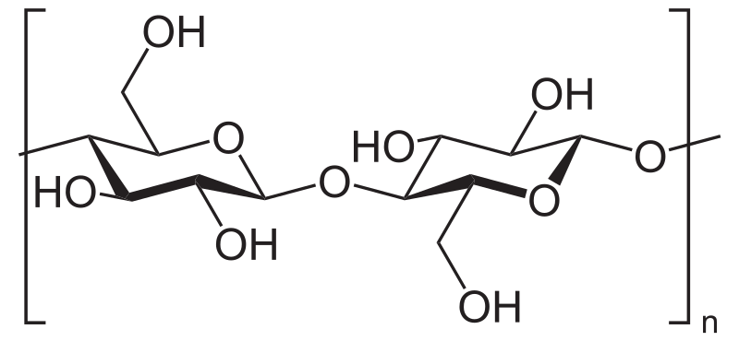

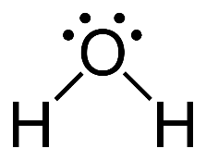
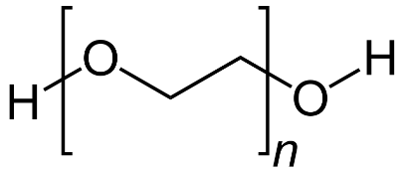
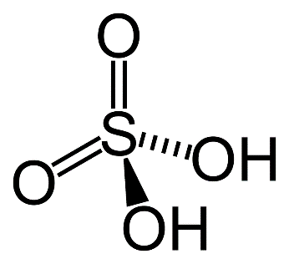
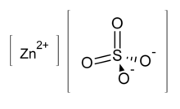
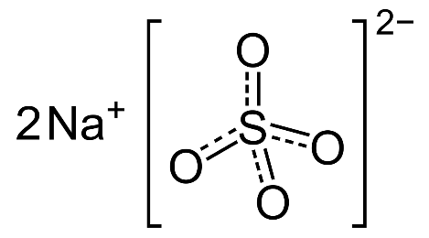

RAW MATERIAL & CHEMICALS
Cellulose
Sodium hydroxide
Carbon disulfide
Water
Surfactants
Viscose
Sulfuric acid
Zinc sulfate
Water
Surfactants
Spinbath
Carbon disulfide
Sodium sulfate
Rayon

Slide 9

UTILITIES
Labe river
Others
Water
Spinning
Coal boiler, gas turbine
Spinbath
Steam
Others
Spinning
Outer net
Gas
Spinbath
Outer net, gas turbine
Others
Power
Spinning
Spinbath

Slide 10
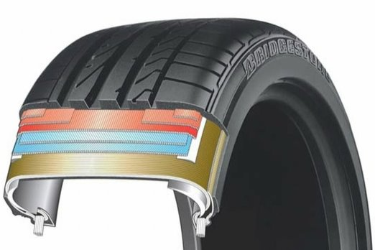
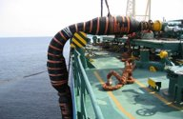
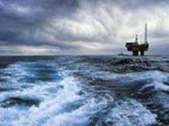
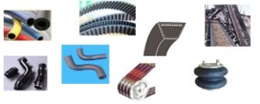

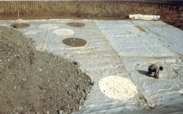
PRODUCTS

Slide 11
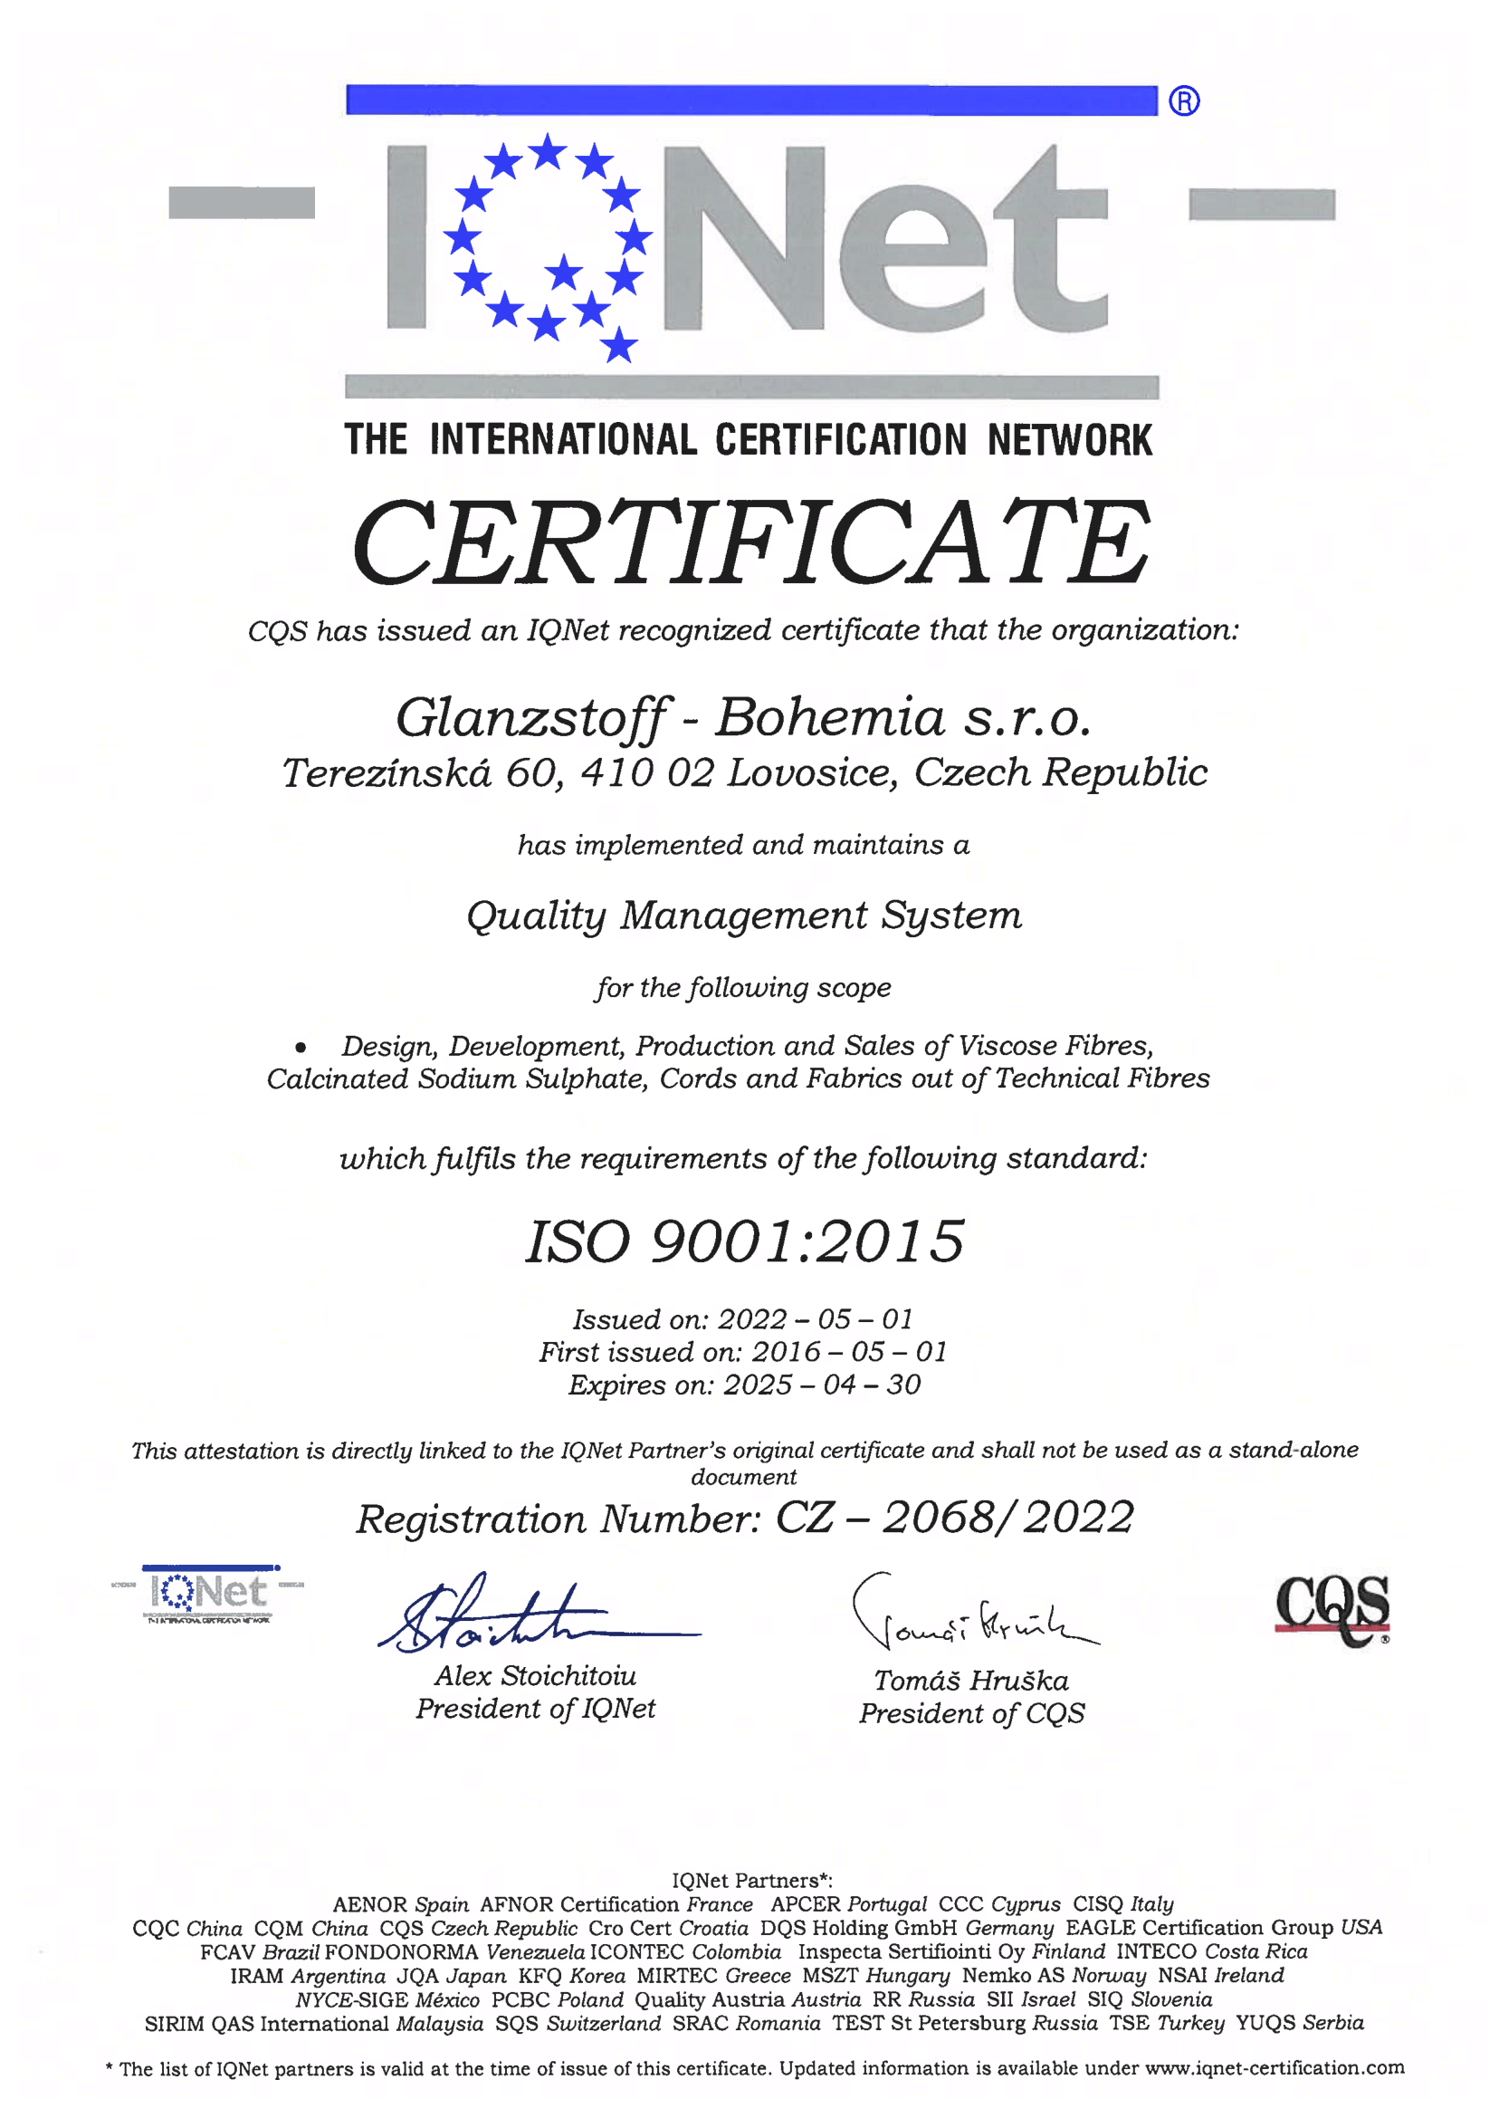
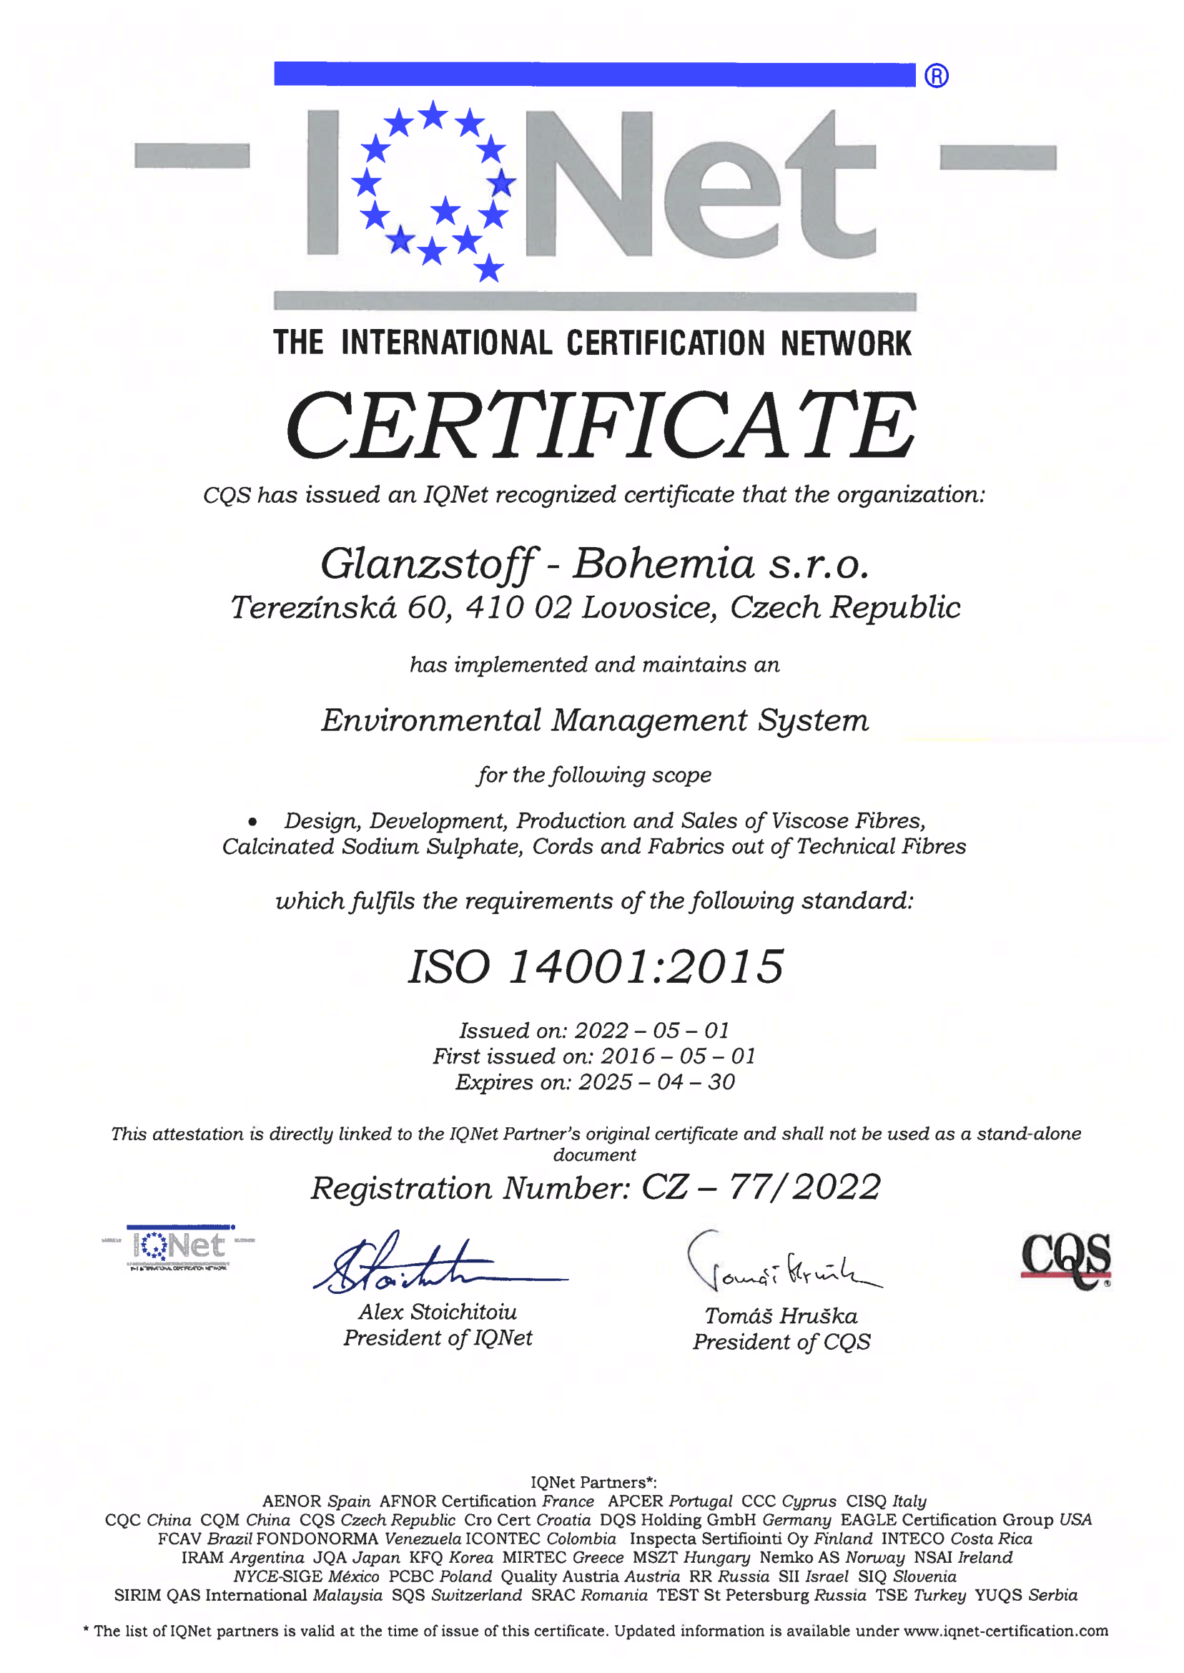
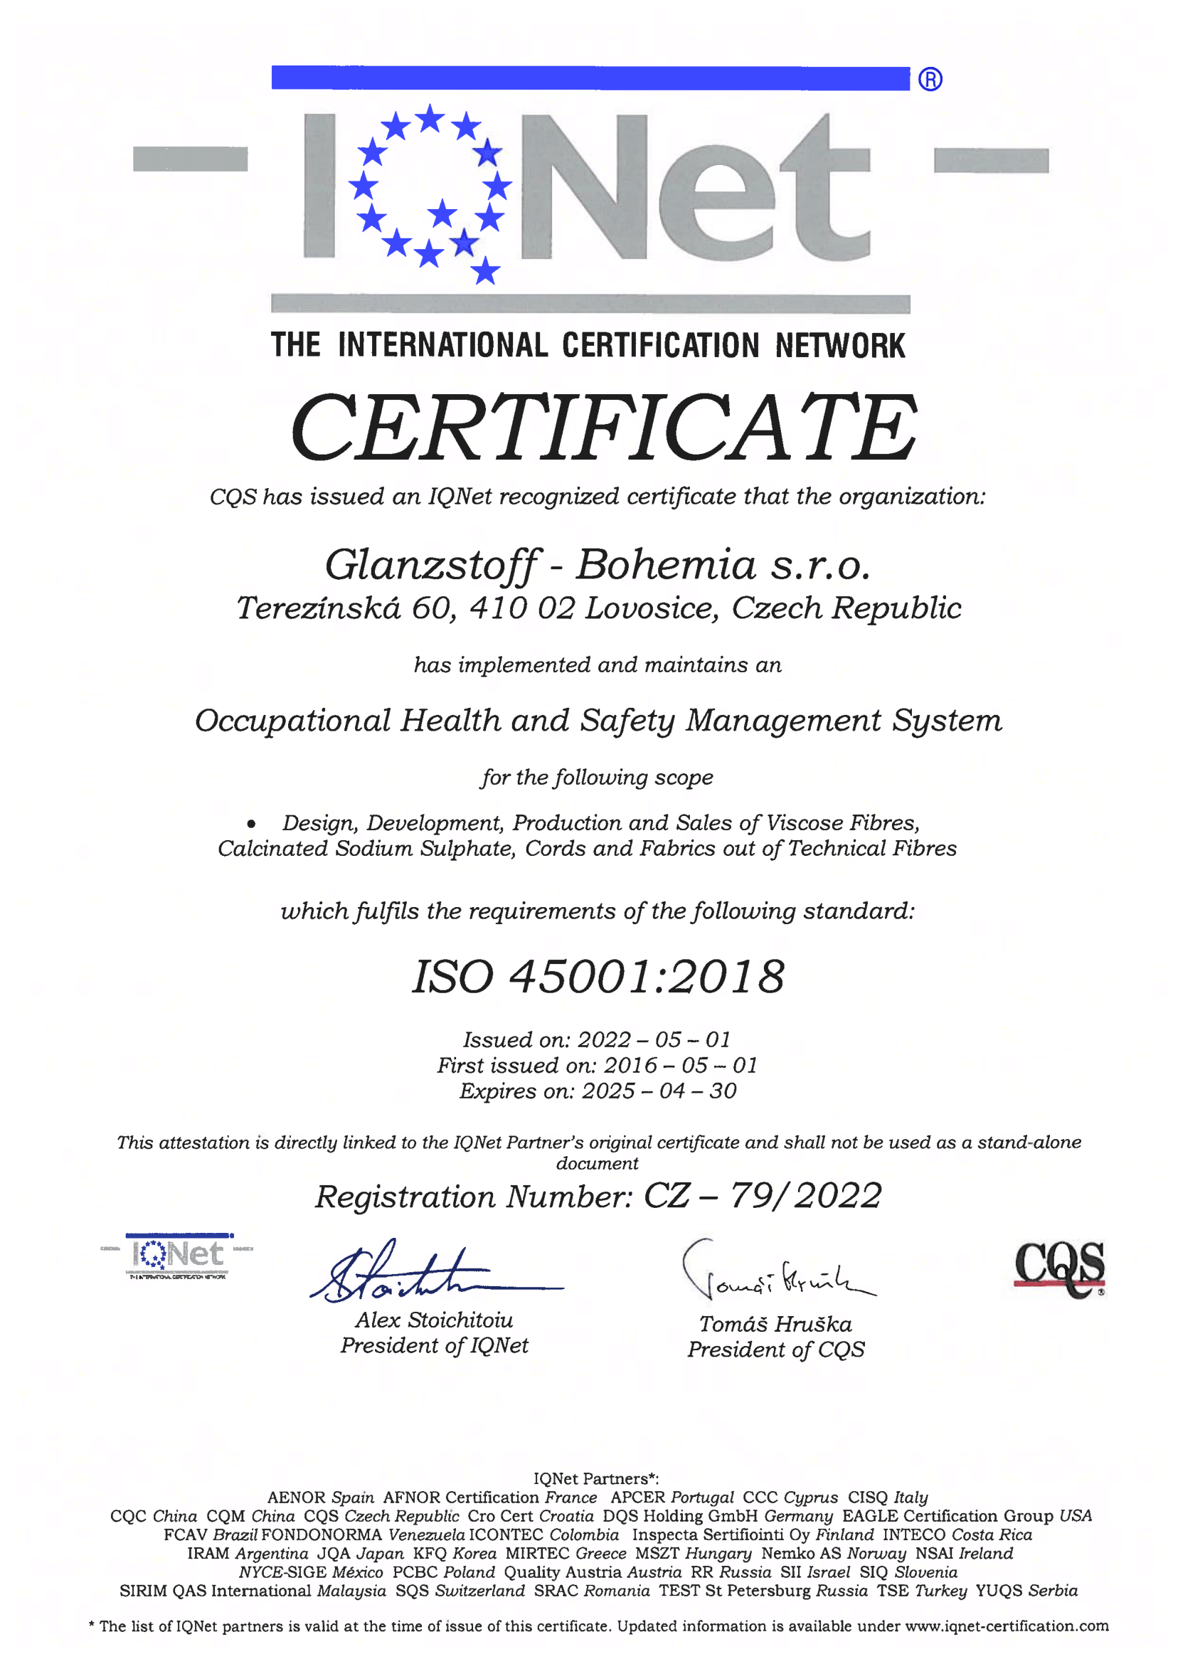
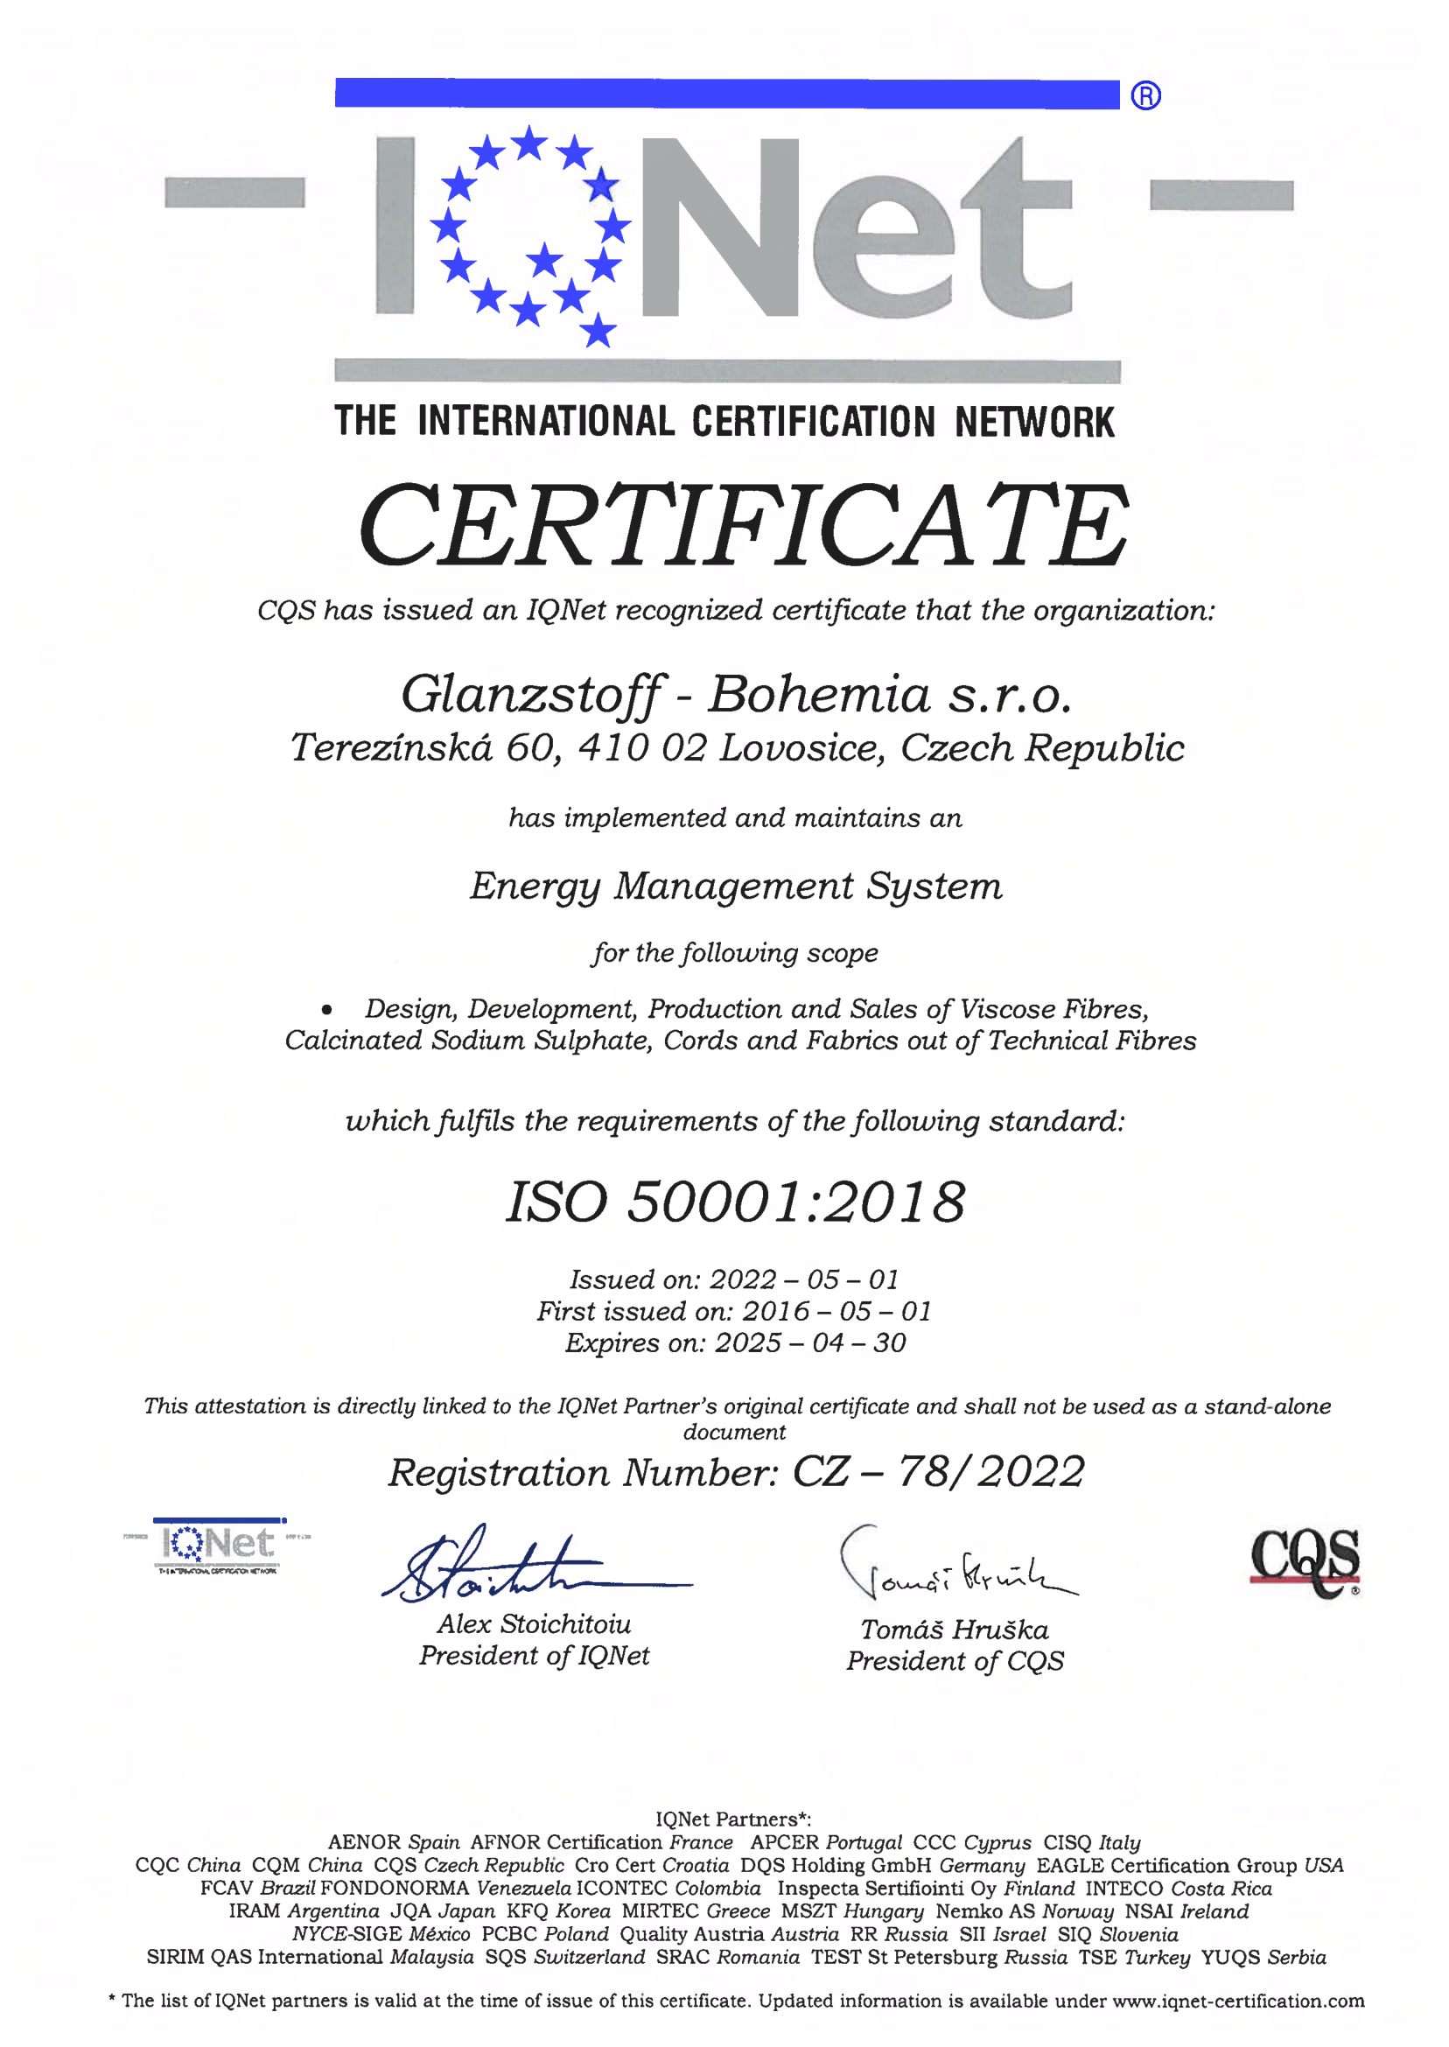
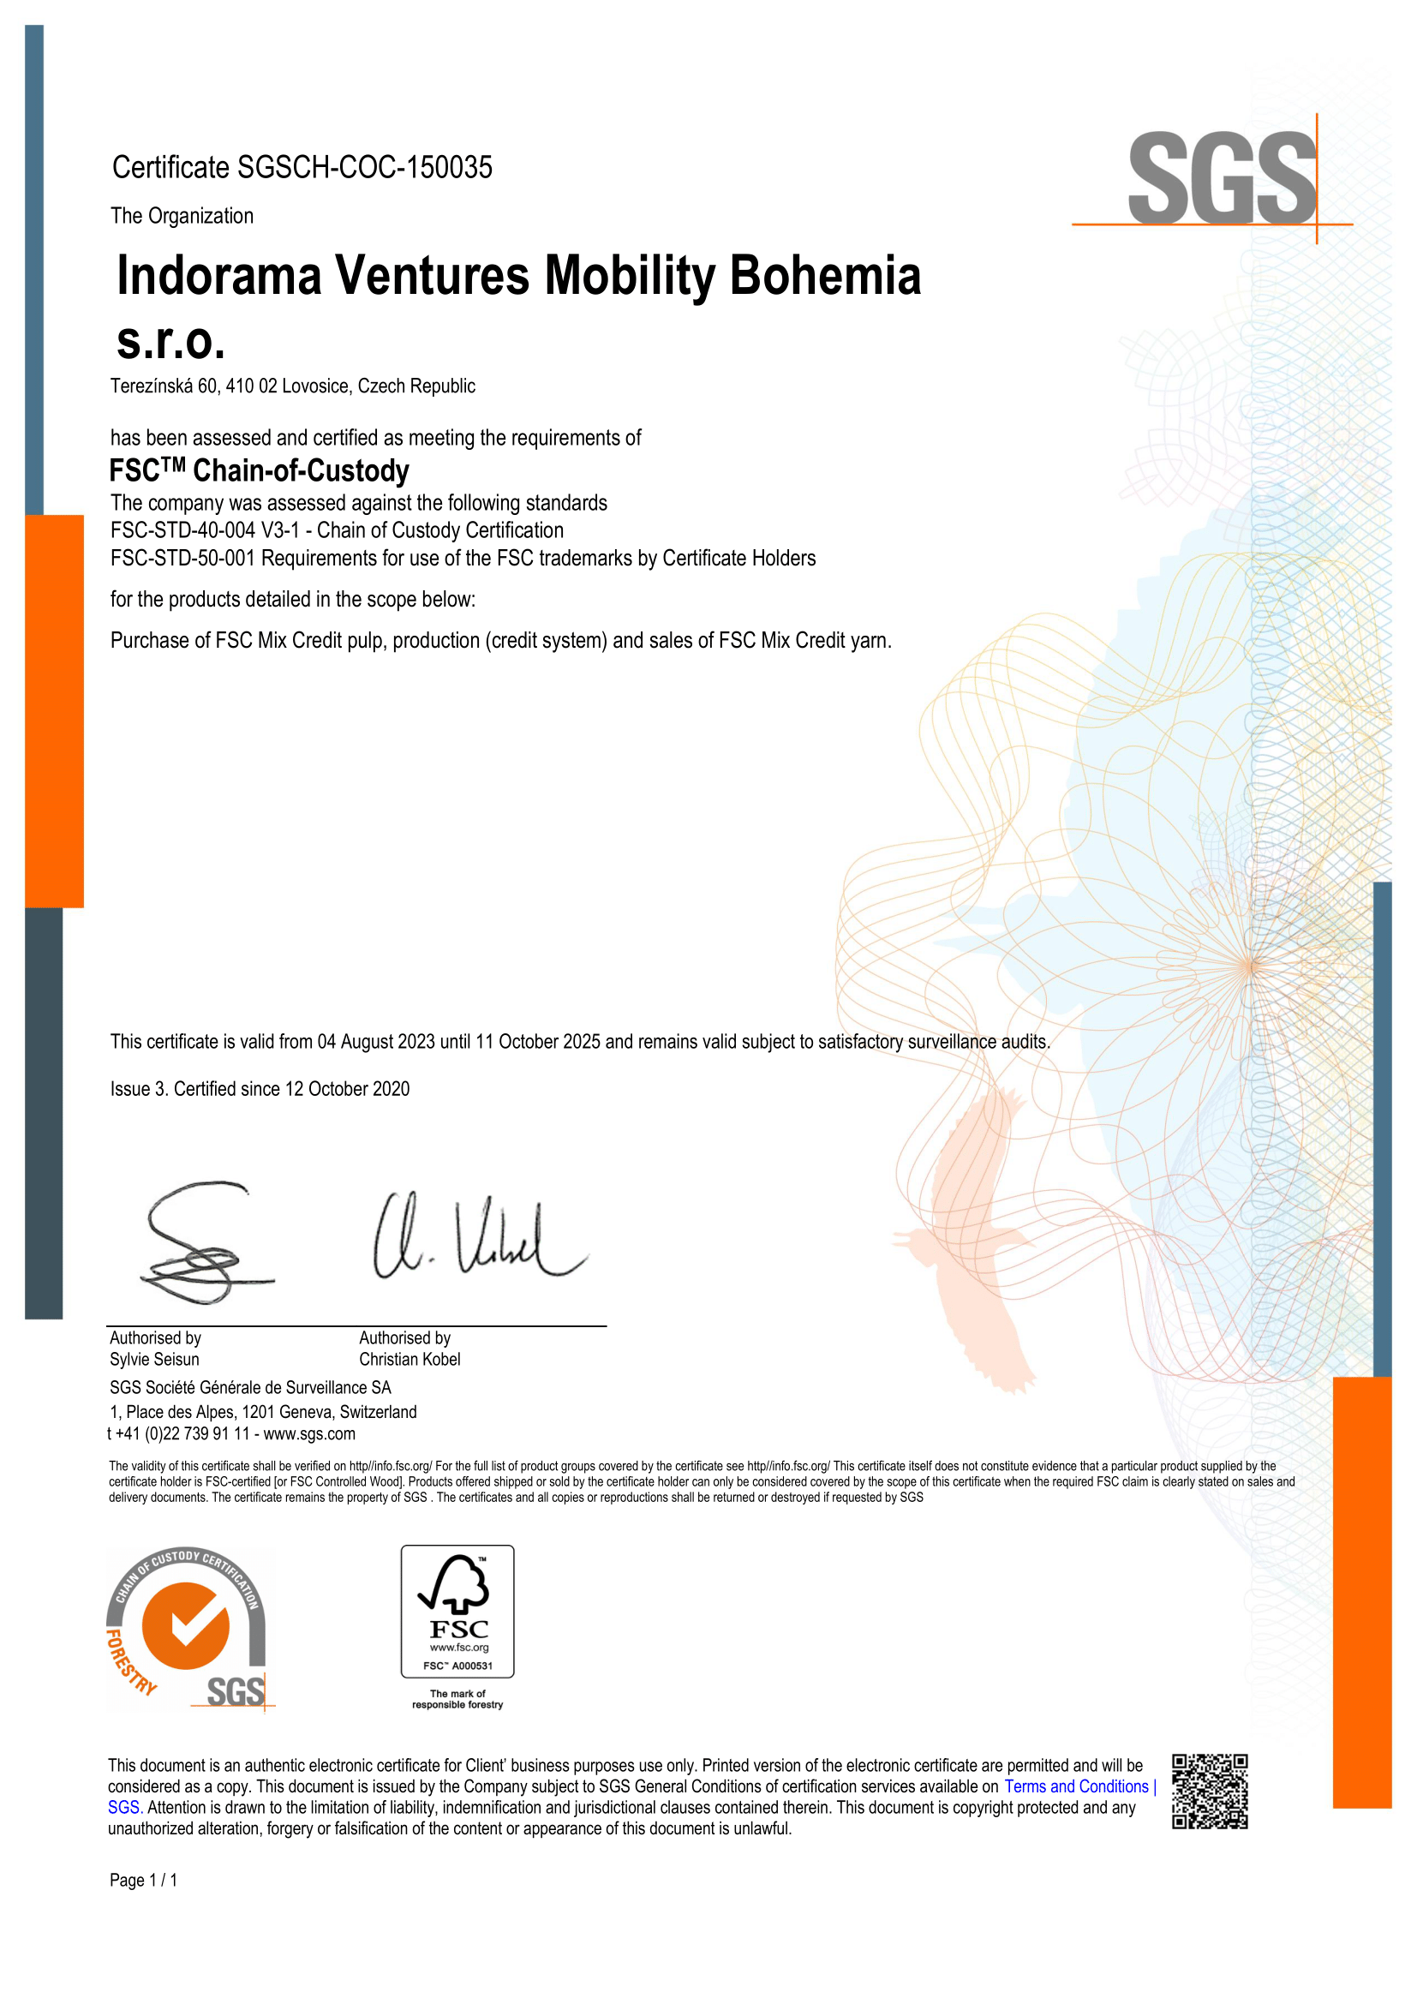
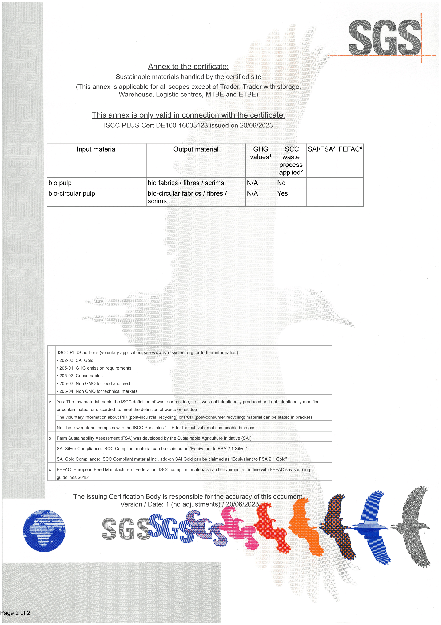
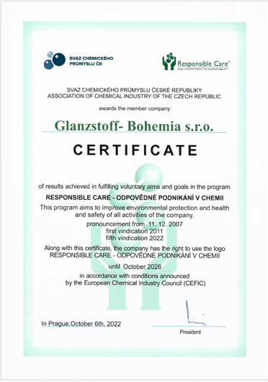
CERTIFICATIONS
ISO 9001 | ISO 14001 | ISO 45001 | ISO 50001
FSC CoC | ISCC PLUS | RESPONSIBLE CARE

Slide 12
EHS standards and local law
Internal audits
Safety week
Records of near misses
Good idea database
Contracted companies management
ISO 45 001
Responsible Care
Safety inspections
LOTO
HAZOP
Process Hazard Analysis
SAFETY STRATEGY
The aim of the occupational health and safety strategy and the management system that follows it is to implement technical and organizational measures that can reduce or eliminate risks leading to damage to health in the company's workplaces.
Care for health and safety at work, continuous improvement of working conditions, knowledge of regulations to ensure work safety and safety of technical equipment is an integral part of fulfilling the work duties of all employees.

Slide 13
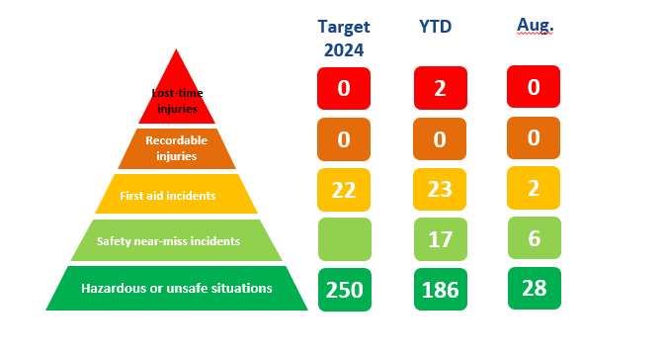
SAFETY REPORTING

Slide 14
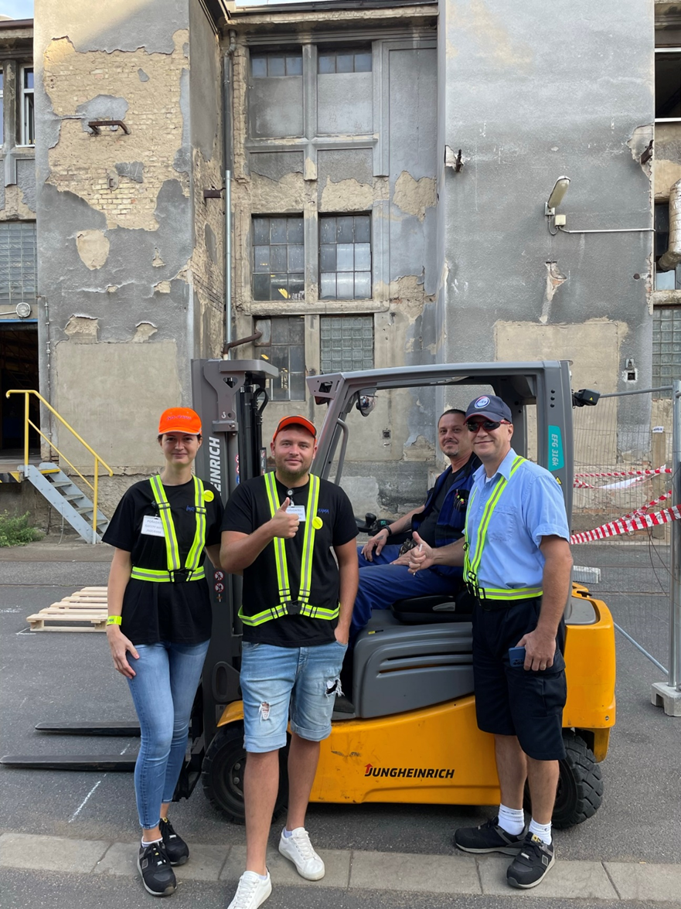
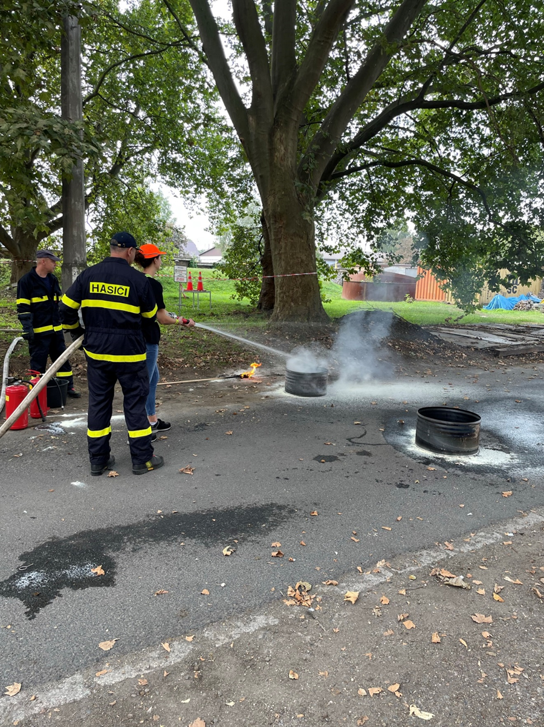

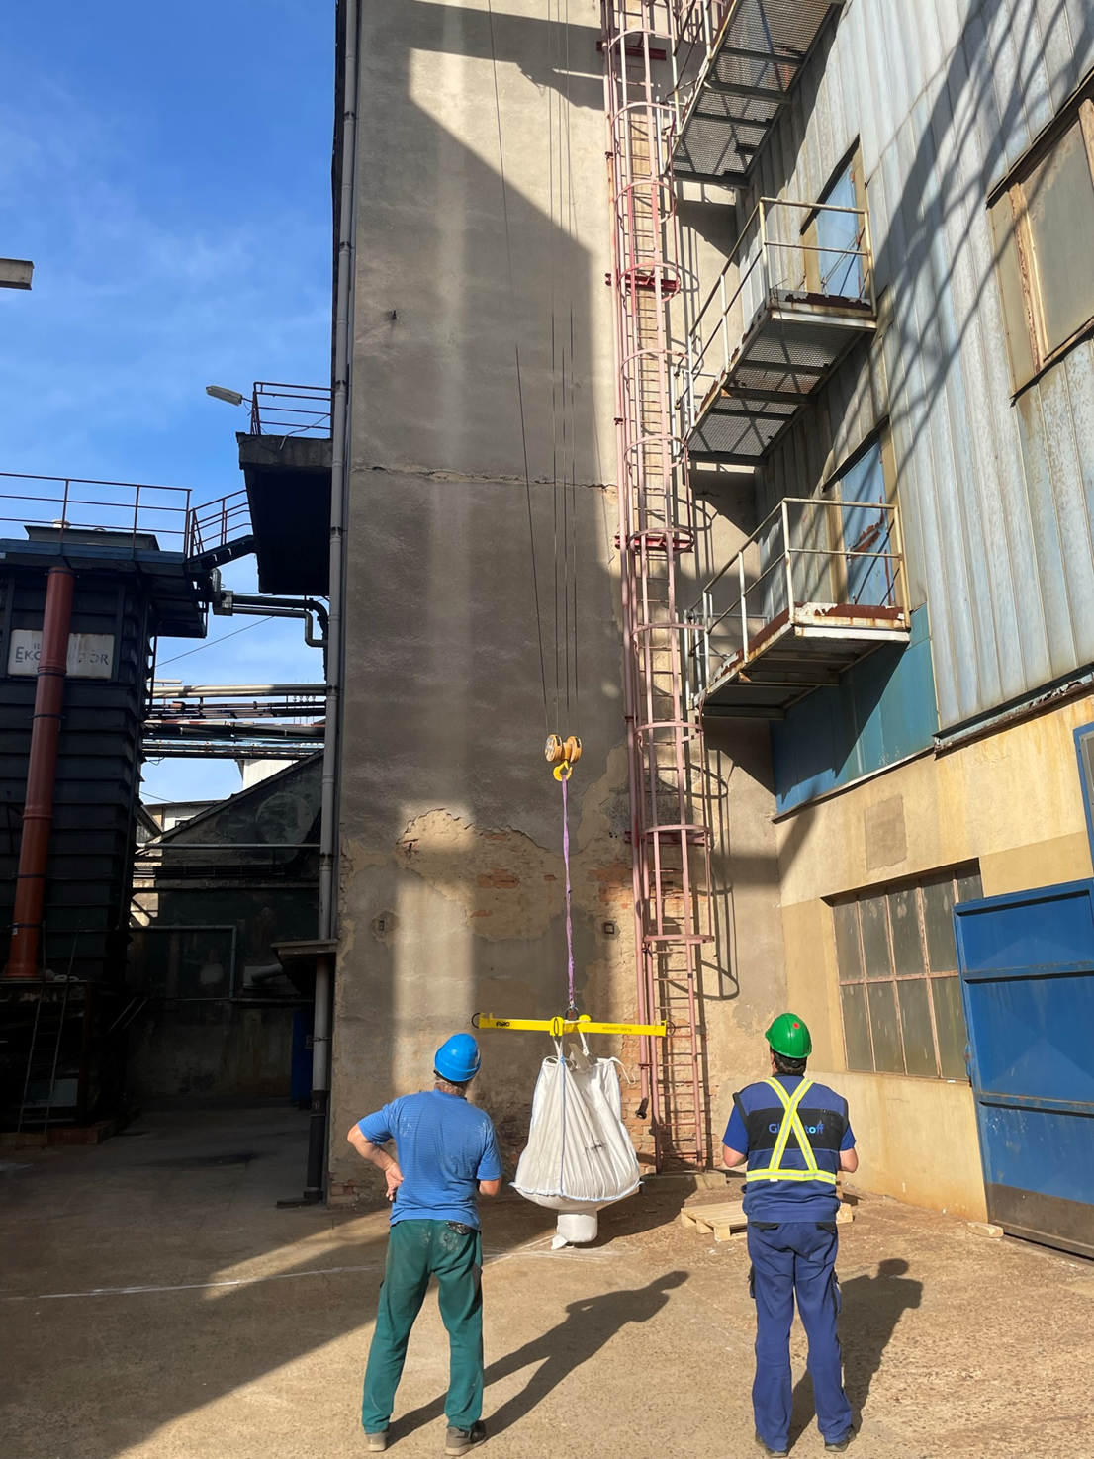
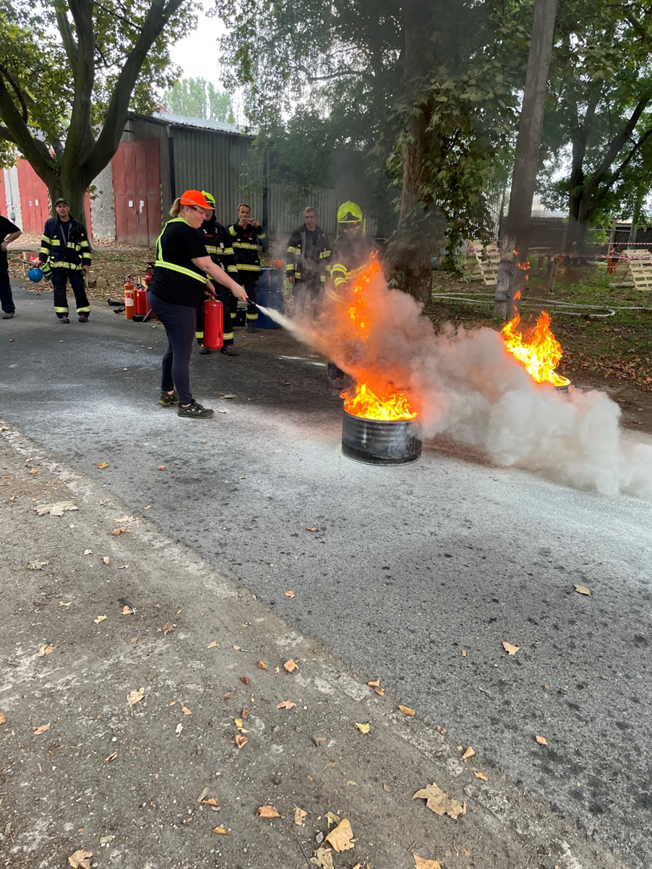
SAFETY EVENT

Slide 15
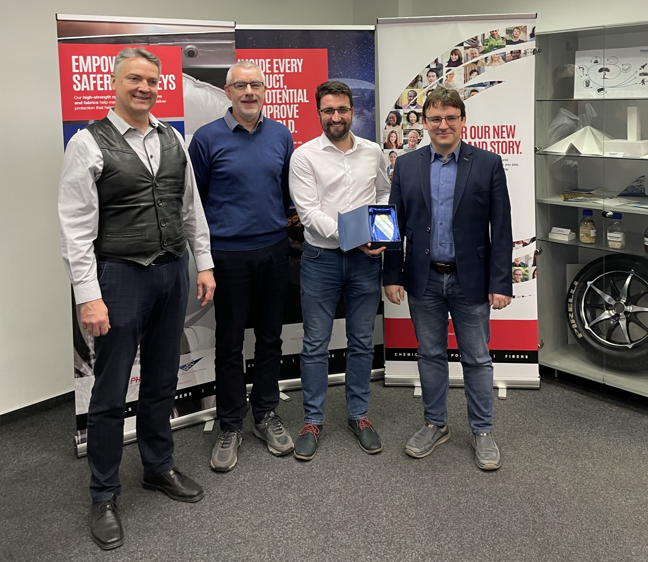
EHS EXCELLENCE AWARD
Viscose waste reduction project during production startups
Notes:
Jak jsme dostali s Davidem tu cenu, tak nějakou fotku, nějaký popis za co :D (divné chtít to po tobě, ale fotku nemám a za co to bylo už taky nevím)

Slide 16

THANK YOU
Reimagining chemistry together to create a better world​

